Slide 1


“
Welcome to Oak Class
Meet the teacher meeting!

Slide 2
Expectations in Oak Class
Attendance and punctuality
Home Learning – TTRS and spellings are weekly, reading is expected at least 3 times a week.
Reading Records - to be signed 3x weekly as part of home learning
Spellings – The pupils will have a copy of the Y3/4 spelling list in their home learning books. We will be having weekly spelling lists and activities too from Spelling Ninja.
Home Learning club is completed with myself or Mrs Barnes if TTRS or reading records are incomplete
Multiplication facts-learn them, Y4 have the MTCs
Expectations of work-try your best, take care with presentation!
Every child is different and need different things to succeed.

Slide 3
Expectations in Oak Class
Maths-please see the booklet Mrs Barnes has put together for each year group that will be given out to your child.
English-to be able to spell all of the Y3/4 words by the end of Y4.
For a Y3/Y4 writer-Fronted adverbials, prepositional phrases and paragraphs, expanded noun phrases, spelling rules, apostrophes and punctuating speech, as well as everything they have learnt in previous year groups.
Reading-a range of texts fluently, asking questions and discussing vocabulary.
There is a link for the books recommended for your child’s age group. https://schoolreadinglist.co.uk/category/reading-lists-for-primary-school-pupils/

Slide 4


Slide 5
Behaviour
These are our expected behaviours that all pupils need to be aware of and follow:
Expected Behaviours
Follow instructions
Listen to others
Respond appropriately
Keep hands, feet and objects to yourself
Be respectful and kind
Stages of consequences for unexpected behaviours-warnings, time away, parent meetings and SLT.

Slide 6
Autumn Weekly Routine
PE – Monday and Friday
Art/DT – Wednesday
French-Wednesday with Mrs Barnes
Pupils to come in wearing their PE Kit with their uniform in their bag incase of bad weather.

Slide 7
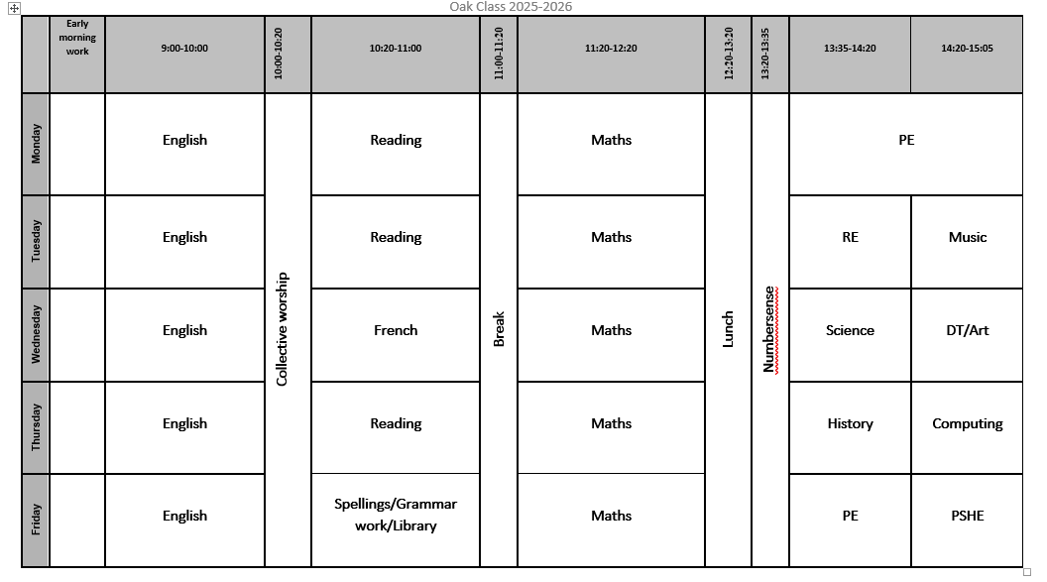
Weekly Routine

Slide 8
Help at Home
Times Tables
Reading for pleasure
Time – analogue, digital, 24hour
Real life maths problems-just talking
Encourage Writing – diary, stories, information texts.
Hear your child read, read with your child and question them on the text.
If you want extra work-the CGP books are good-the grammar and maths ones.

Slide 9
MTCs
Year 4s-
National test
25 questions
6 seconds to think of the answer and type it in.
Any facts between the 2 and 12 times tables (remembering 1 x anything is itself and 0 x anything is 0).
TTRS helps
There are also other websites that help too-hit the button and speed test multiplication facts.
https://www.timestables.co.uk/speed-test/
https://www.topmarks.co.uk/maths-games/hit-the-button

Slide 10
Resources
Children must bring:
Art Shirt:
An old shirt or t-shirt to protect school uniform during Art or DT.
Pencil Case
Pencil, glue stick, rubber, sharpener, colouring pencils and a ruler.
Water Bottle-so important
All items brought to school MUST be labelled.

Slide 11
Resources – Pencil Case
Children must bring:
Labelled pencil case
Pencils
Ruler
Rubber
Sharpener
Handwriting pen (if they have been asked to by me!)
Children can also bring:
Colouring pencils
Felt tip pens
Highlighter pen(s)
Scissors
Glue stick
All items brought to school MUST be labelled. They don’t need a compass!

Slide 12
Uniform
General information:
School jumper-navy
School polo-shirt-blue
Grey trousers/shorts/skirts
Grey tights
Grey socks
Black shoes
PE kits-yellow polo shirt, navy joggers, shorts or leggings, navy socks, black trainers.
All items brought to school MUST be labelled.

Slide 13
Healthy lunches and snacks
We need to teach our children healthy choices to help them become healthy adults.
Fruit and vegetables for break time.
Balanced lunch box.
No products containing nuts are allowed at school.
If ordering school lunches, please do so on Arbor before the morning of that school day.

Slide 14
Topics
Oak Class Topics:
Geography:
Comparing 2 continents
Sustainability
History:
Stone Age
Egyptians
Vikings
Science:
Electricity, States of matter, Teeth and Digestion, Sound and habitats.

Slide 15
Educational Visits
There will be visits linked to different topics throughout the curriculum.
Science Museum in London is booked for Wednesday 24th September. Please speak to the office if you need the information again.
Swimming will be in the Spring term.
-Sports events-there is normally at least 1 per term for each key stage. If your child shows an interest, a letter will be emailed out and then you sign up on arbor. If your child cannot attend, it is really useful to let me or the office know as we are normally restricted by numbers and have to take a certain number!

Slide 16
Clubs
Tuesday-Judo at lunch time
We have the Treehouse club which is our wrap around care. Please speak to Sophie in the office for more information.

Slide 17
Partnership Between Parents and Teachers
Parents’ Evening (Autumn and Spring Terms)-the Autumn ones are on the
Termly Curriculum Map and knowledge organisers
Parent/Teacher meetings can be arranged at the office
Class Dojo-we can message each other on that.
Summer Report
Please also note that I am always available for an informal chat in the playground after school.

