Slide 1


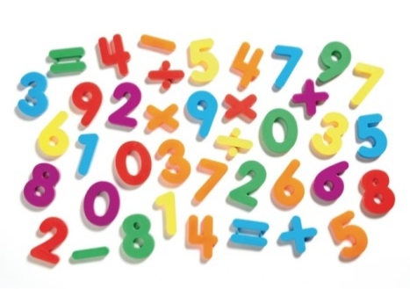
St Sebastian’s Church of England Primary School and Nursery

Slide 2

Maths Calculation’s Information Session
How we teach Maths at St Sebastian’s
We teach Maths mainly using the White Rose Hub Scheme, which which was developed in Singapore. It is supported through the C.P.A (concrete, pictorial abstract) approach.
Maths Vision
We aim for all children to have a positive attitude towards Mathematics and view it as an interesting and valuable subject. It is our intention, that every child will develop a good understanding of the subject, equipping them with the skills of calculation (including a secure recall of key facts), reasoning and problem solving, that they need in life beyond school. We endeavour for all children to be confident learners, working collaboratively, co-operatively and independently and are able to express their ideas fluently using mathematical vocabulary.

Slide 3

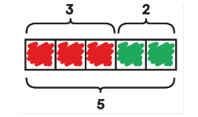

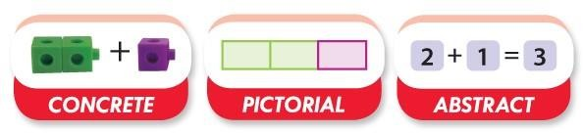
What is CPA
Jerome Bruner - three steps (or representations) necessary for pupils to develop understanding of a concept.
Concrete- The DOING
The ‘doing’ stage – physically using objects to explore a concept. This helps bring the abstract concepts to life.
Pictorial-The SEEING
The ‘seeing’ stage – images are used to represent the objects.
This stage encourages children to make a mental connection between the physical object they have just handled and the abstract pictures, diagrams or models that represent them.
Simply put, it helps children visualise abstract problems and make them more accessible.
Abstract – The SYMBOLIC
A child is now capable of representing problems by using mathematical notation, The ‘abstract’ stage – symbols and numbers are used to model the problem or calculation. The teacher uses operation symbols (+, –, x, /) to indicate addition, multiplication, or division.
Although CPA is presented as three distinct stages, a skilled teacher will go back and forth between each stage to reinforce concepts.

Slide 4
Benefits of CPA Approach
Provides pupils with a structured way to learn maths concepts
Makes learning accessible to all learners
Research has shown that this method is effective
Able to use across year groups from early primary and into secondary
Helps pupils learn concepts before learning rules
More likely to go into long term memory, so pupil have a deeper level understanding and they can retrieve information effectively
More able pupils can use resources to prove or explain a concept

Slide 5
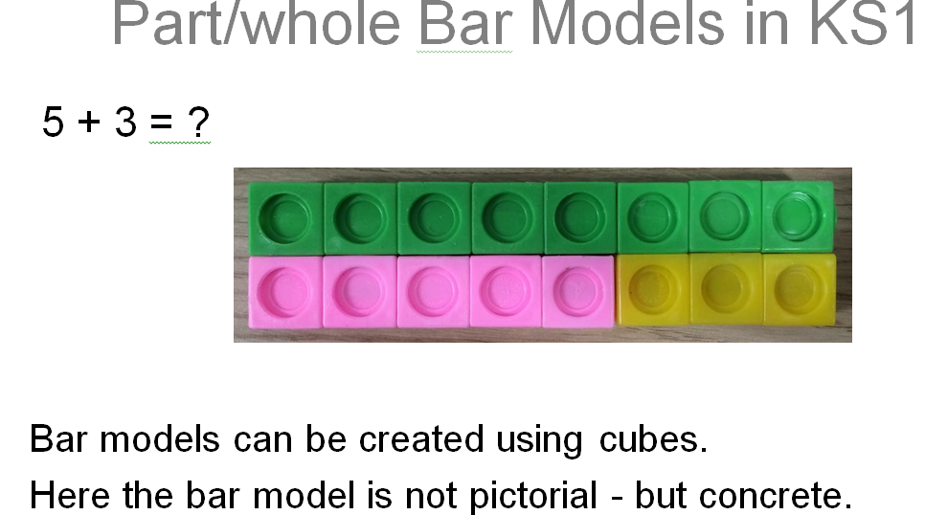
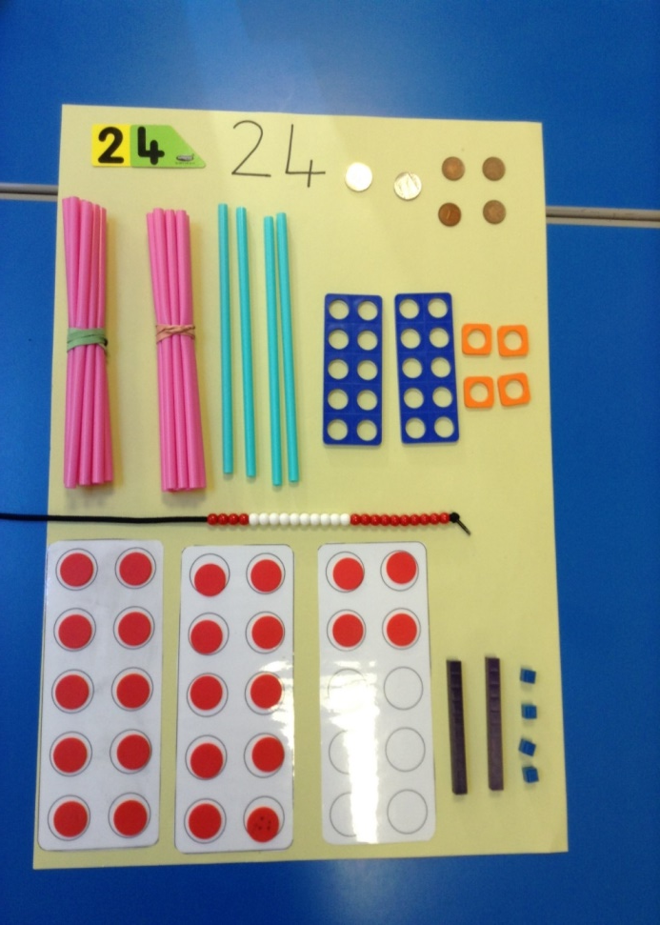
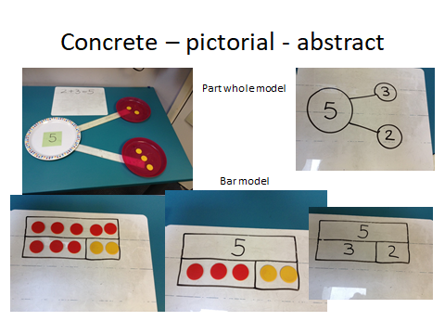
Examples of CPA

Slide 6
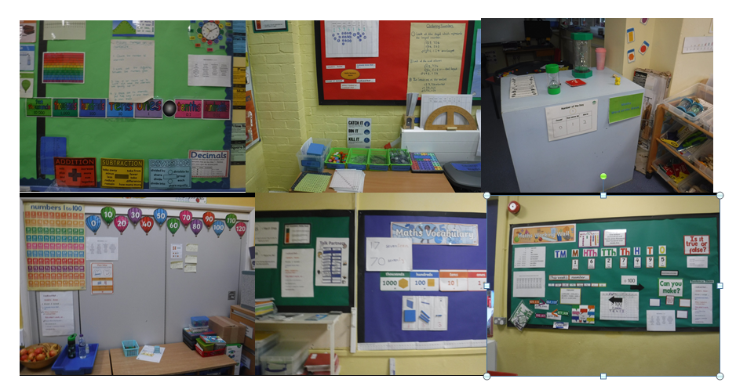
Maths Working Walls

Slide 7
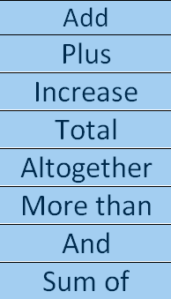

Addition

Slide 8
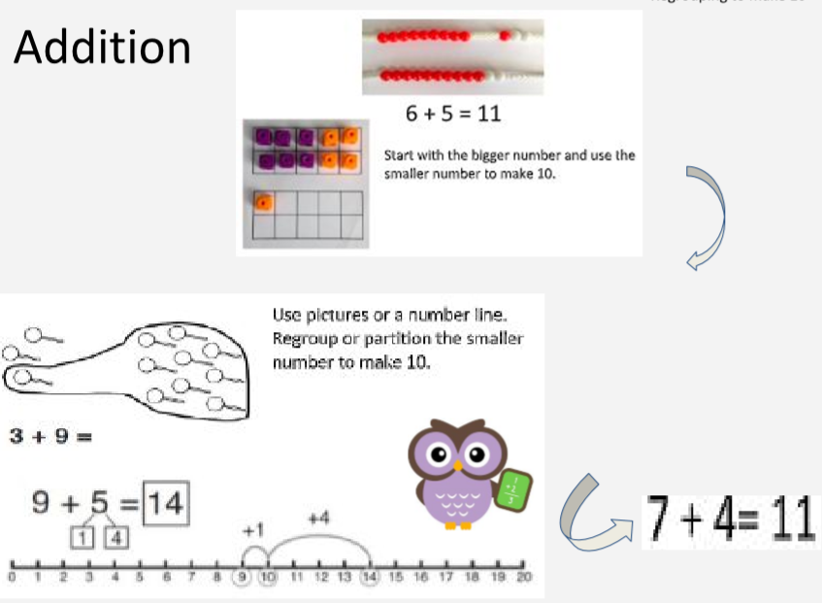
Addition -Regrouping

Slide 9
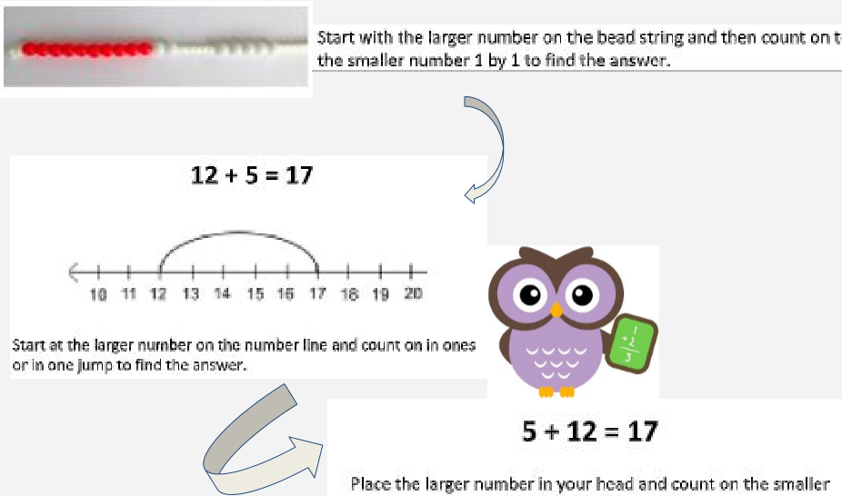
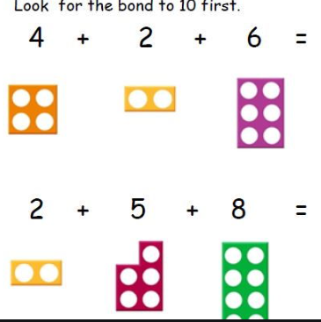
Addition – Using the larger number to count on

Slide 10
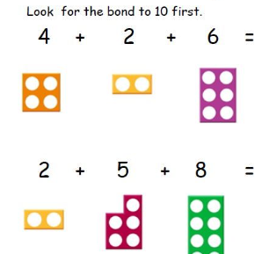
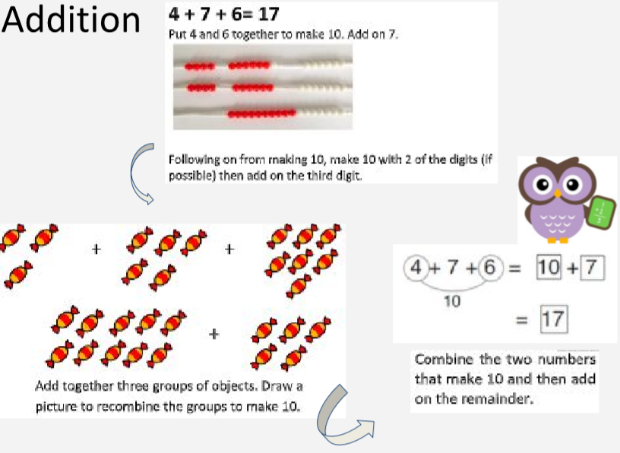
Adding 3 digits

Slide 11
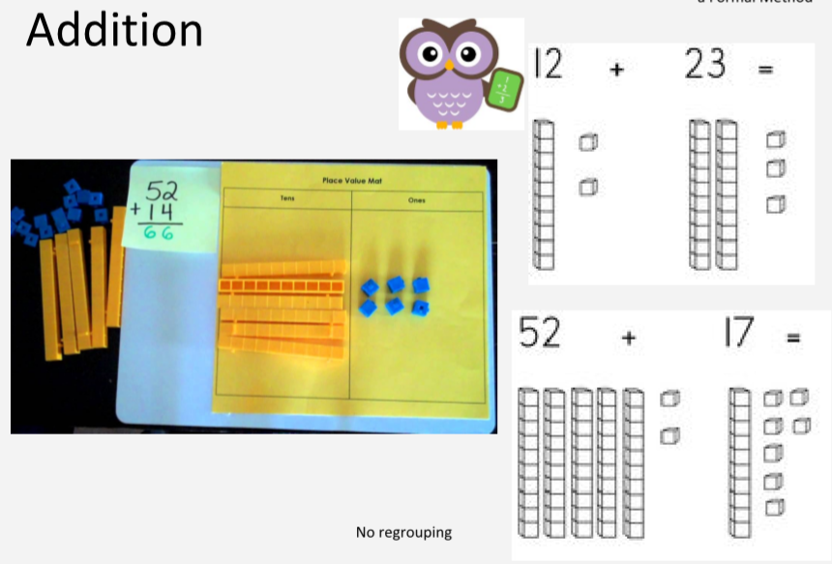
Moving on to more formal methods

Slide 12
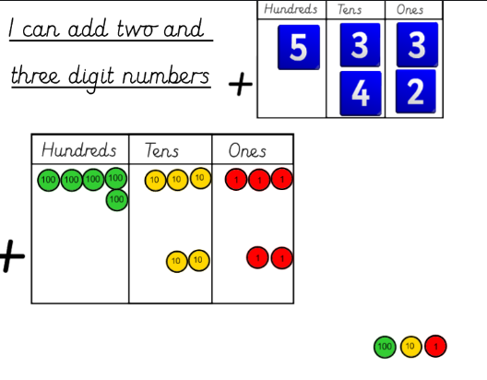
Place Value Counters

Slide 13
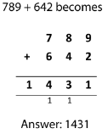
Addition –Formal Methods

Slide 14
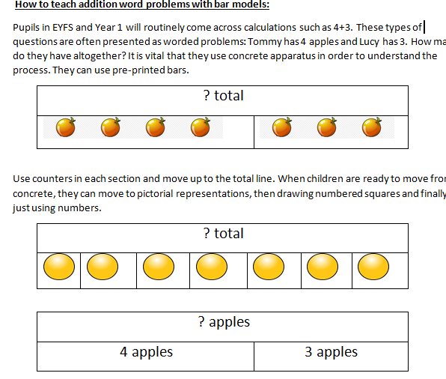
Bar Models – EYFS /Y1

Slide 15
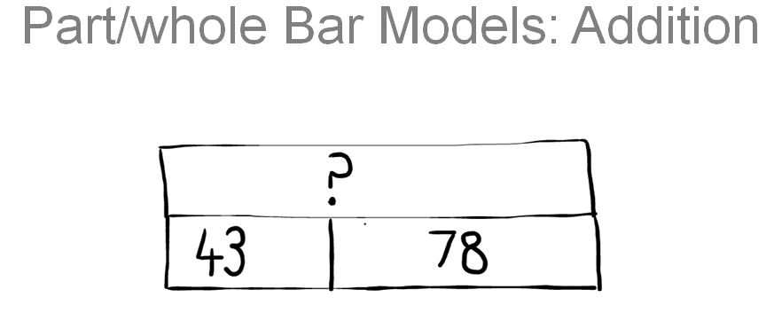
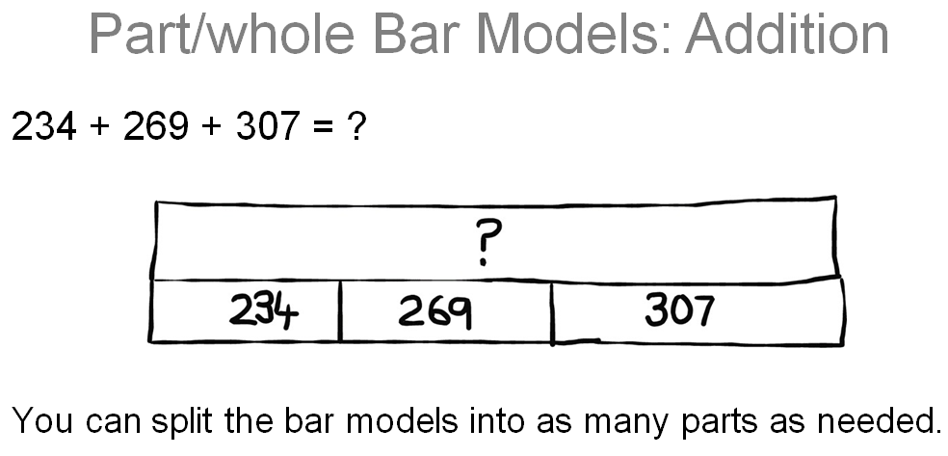
Bar Models

Slide 16
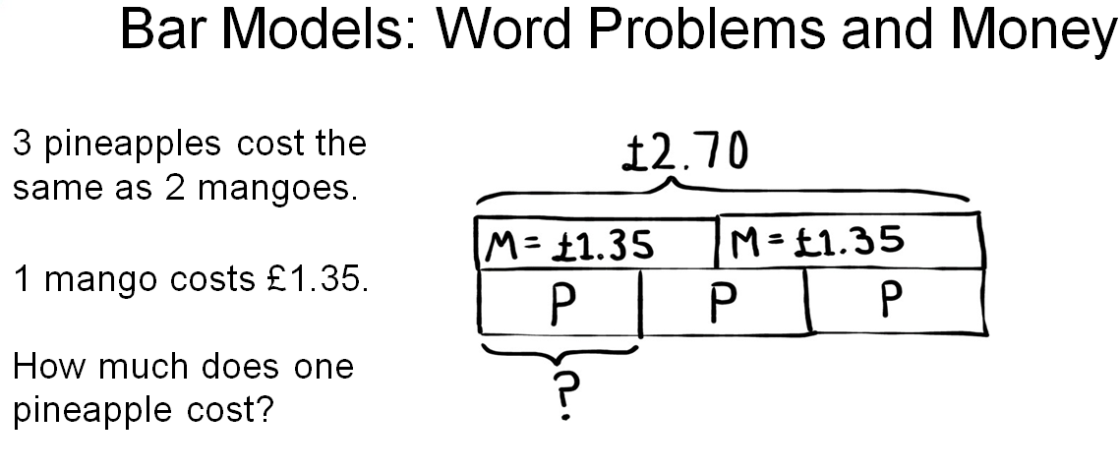
Reasoning Problems from KS2 SAT’s

Slide 17
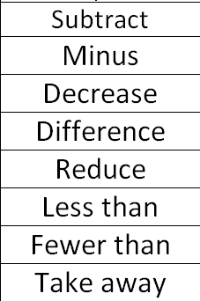

Subtraction

Slide 18
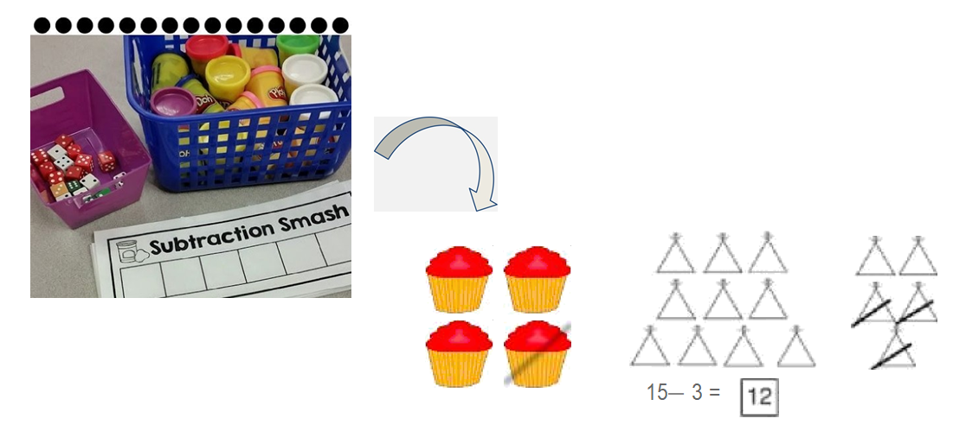
Subtraction

Slide 19
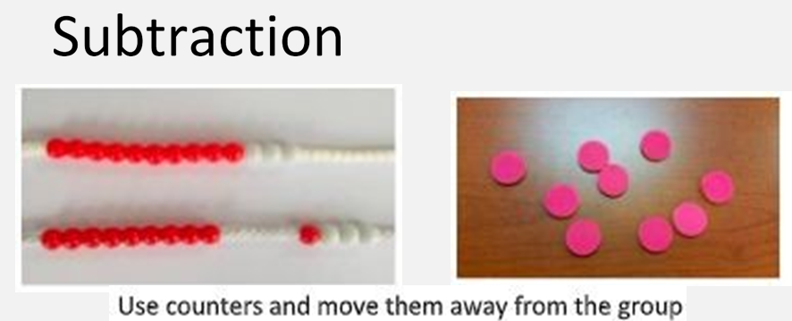
Subtraction

Slide 20
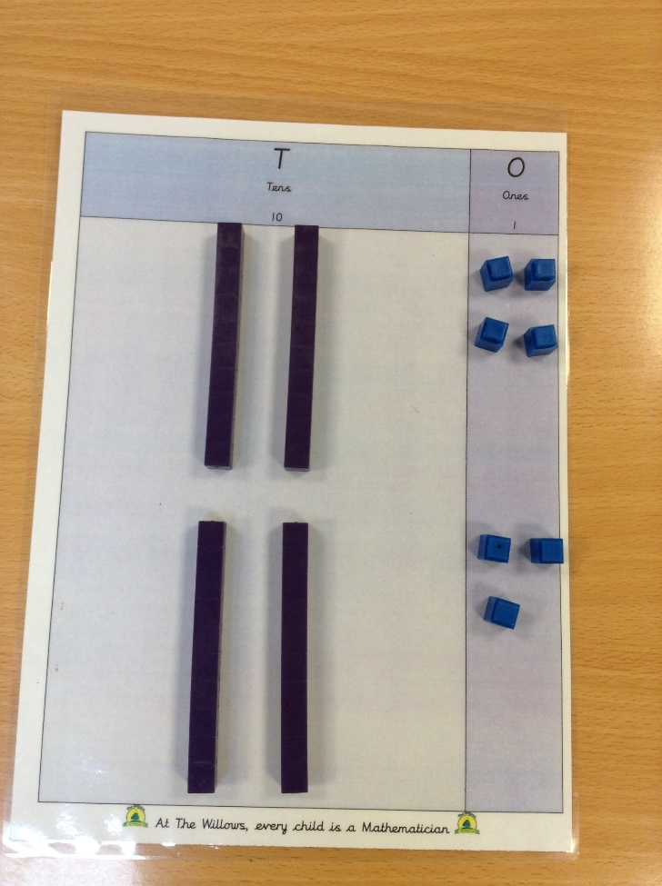
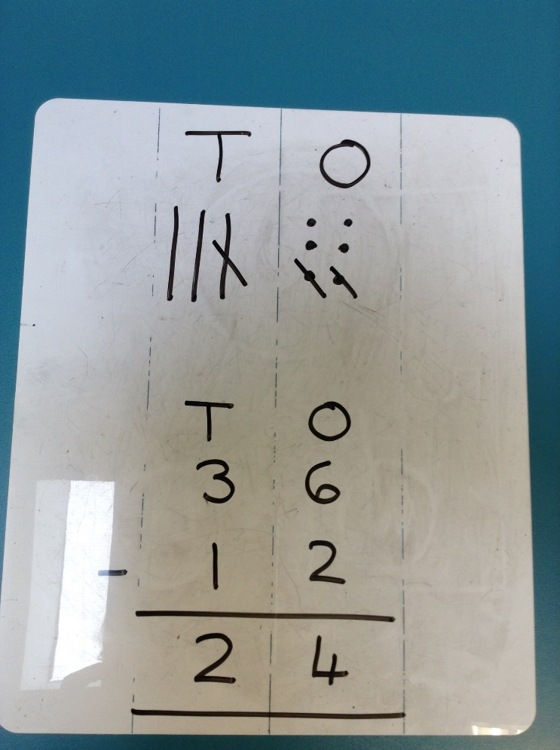
Concrete, Pictorial, Abstract

Slide 21
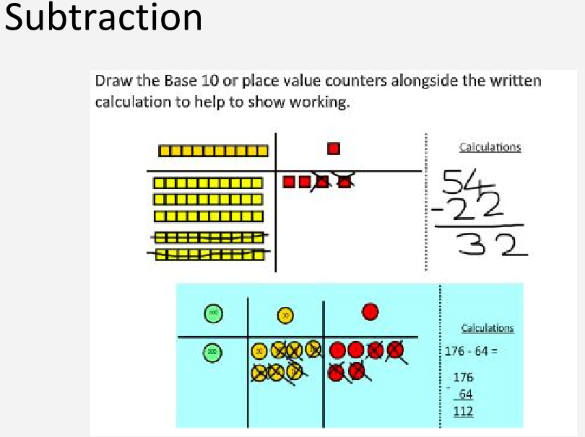

Slide 22
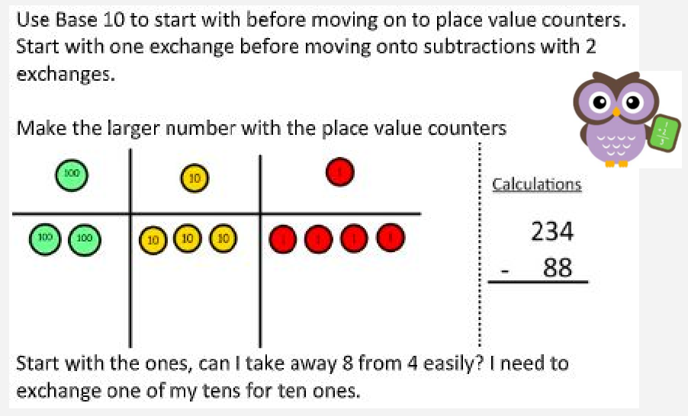
Subtraction with Exchanging

Slide 23
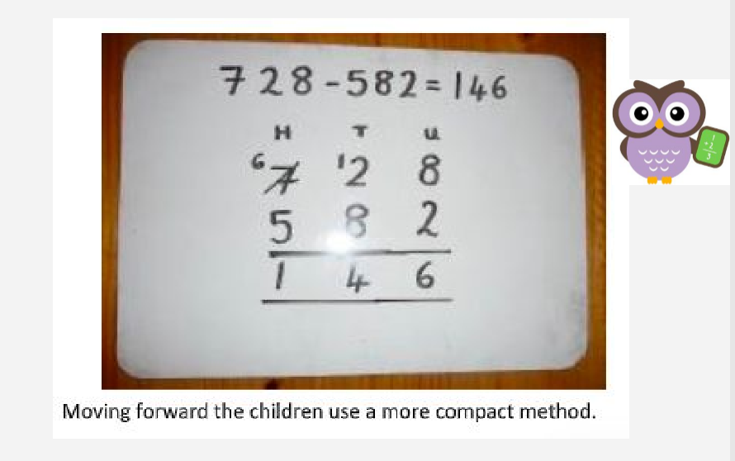
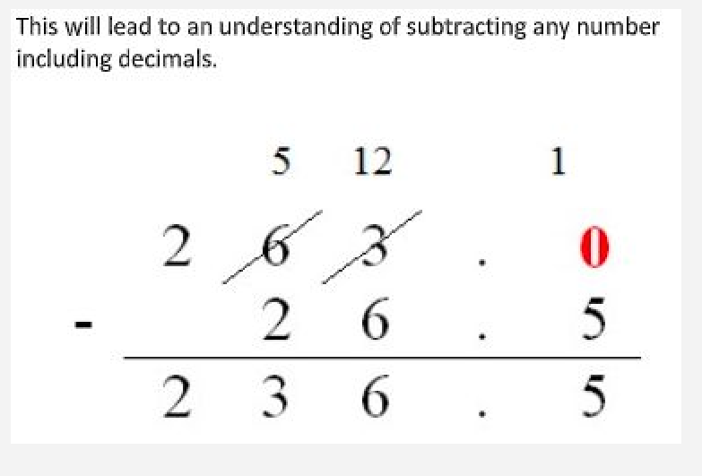
Subtraction with Regrouping

Slide 24
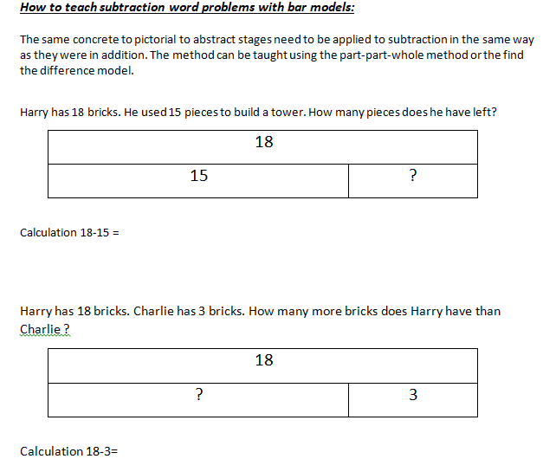
Subtraction –Word Problems

Slide 25
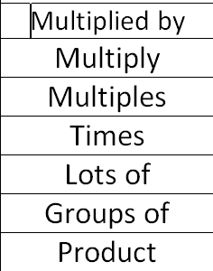

Multiplication
Multiplication

Slide 26
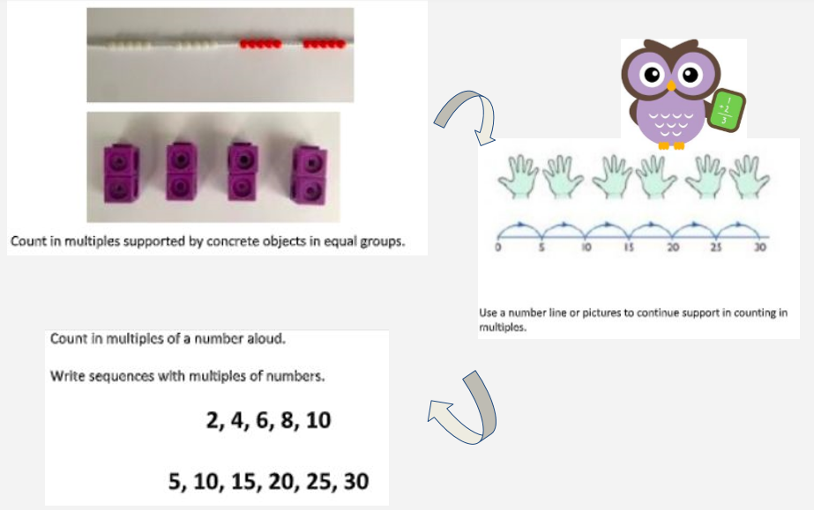
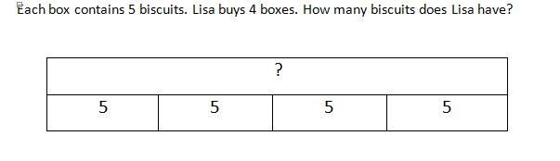

Multiplication-Counting in Multiples

Slide 27
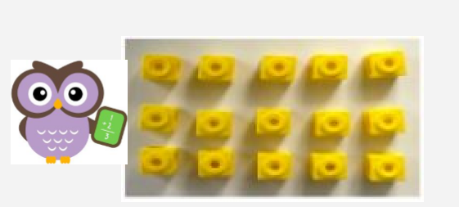
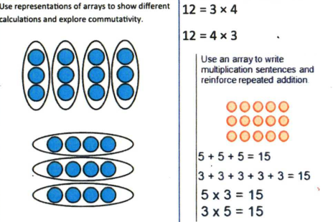
Multiplication -Arrays

Slide 28

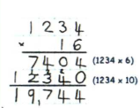
Multiplication – Grid Method CPA

Slide 29
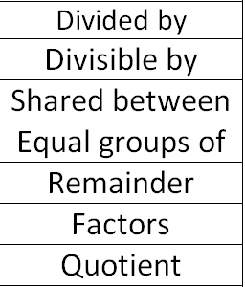

Division
Division

Slide 30
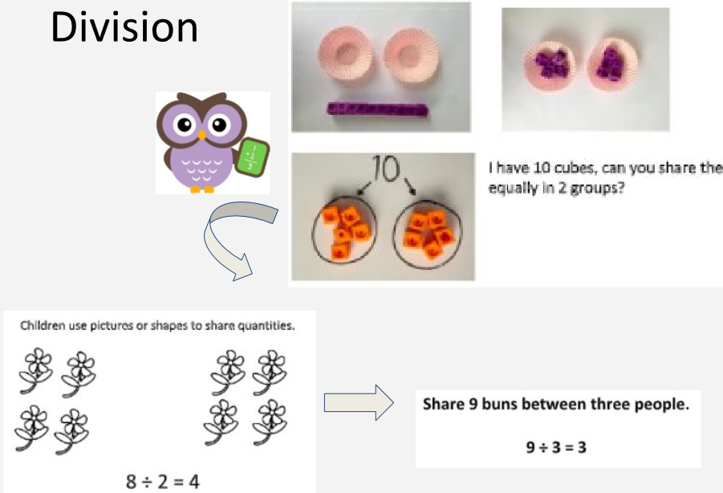

Slide 31
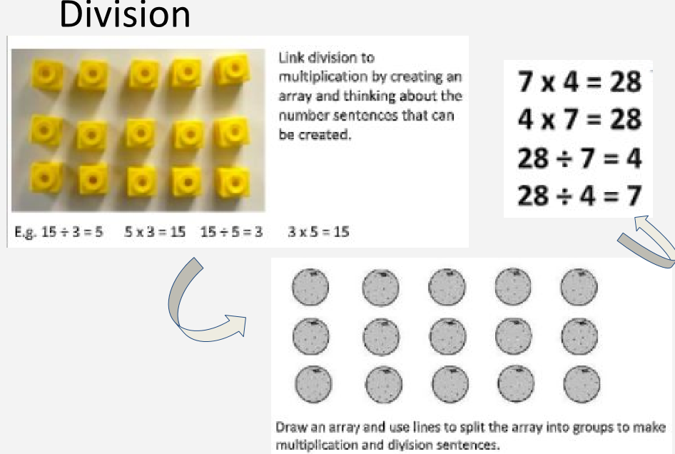
Division as arrays

Slide 32
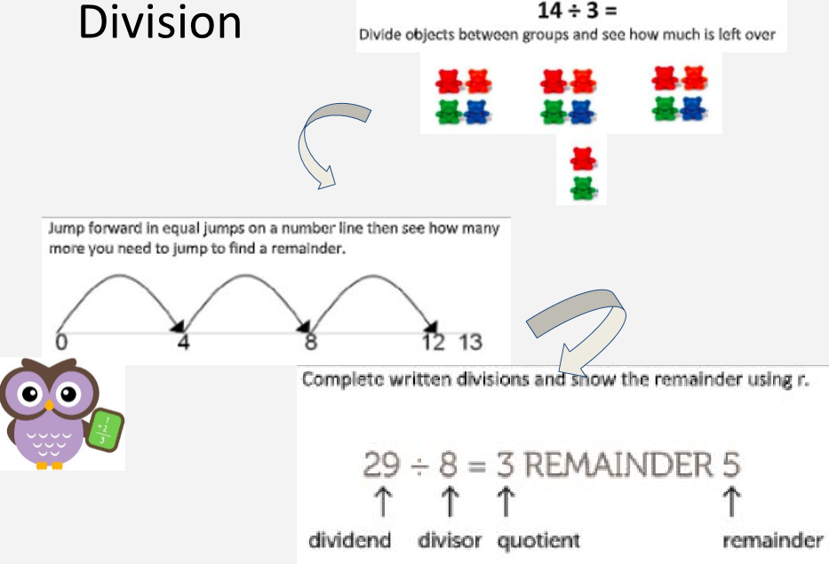
Division with a remainder

Slide 33
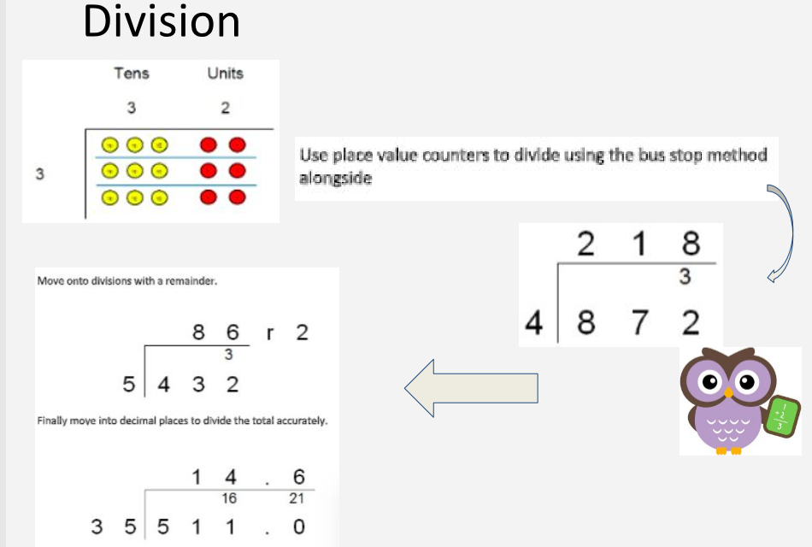
Division

Slide 34
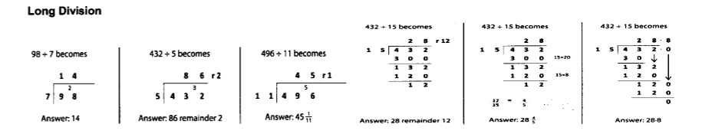
Long Division Formal Method

Slide 35
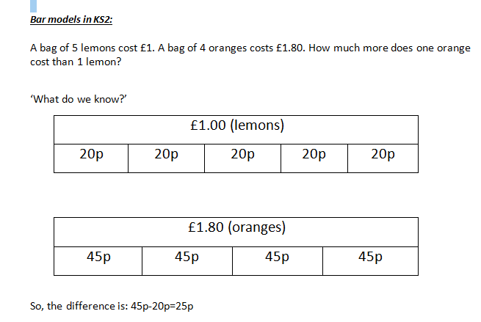
Bar Models – Problem solving in Key Stage 2

Slide 36
Helpful Tips for Parents and Guardians
Believe that every child can be successful in math. It takes good teaching, coaching, encouragement and practice.
Talk about math in a positive way.
Practice core number facts (number bonds , times tables and division). Use Times table Rockstars to help.
Encourage persistence. Some problems take time to solve.
Encourage your child to experiment with different approaches to mathematics. There is often more than one way to solve a math problem.
Encourage your child to talk about
When your child is solving math problems ask questions such as: Why did you...? What can you do next? Do you see any patterns? Does the answer make sense? How do you know? This helps to encourage thinking about mathematics.
Connect math to everyday life and help your child understand how math influences them eg shopping, budgeting, telling time, cooking (weighing, ratio, budgets), diy tasks.
Play family math games together that add excitement such as checkers, Junior Monopoly, math bingo and Uno.
Computers + math = fun! There are great computer math games available on the internet and free apps.

Slide 37
Useful Websites
National Numeracy Parent Toolkit has a wealth of tips and advice for parents. http://www.nnparenttoolkit.org.uk/
Maths 4 Mums and Dads explains some of the milestones children make between the ages of 3-and-11-years-old. http://www.maths4mumsanddads.co.uk/index.php
A fun interactive site with ks2 numeracy puzzles for children aged 6-11. In the parents section we provide explanations for parents of the maths and numeracy http://www.mad4maths.com/parents/
Websites to help children:
Big eyed owl: www.bigeyedowl.co.uk/maths/index.htm (Early Years)
Maths dictionary for kids: http://amathsdictionaryforkids.com/ (Early Years)
Top marks: www.topmarks.co.uk (Suitable for Early Years, Key Stage 1 and 2 and has lots of links to other websites)
Crickweb: www.crickweb.co.uk/Early-Years.html (Suitable for EYFs, Key Stage 1 and 2 children)
Woodlands Maths Zone: www.woodlands-junior.kent.sch.uk/maths (Created by a school in Kent and contains hundreds of interactive maths games aimed at key Stage 1 and 2)
ICT games: www.ictgames.com/resources.html (Aimed at both Key Stage 1 and 2)
KS1 Bitesize: www.bbc.co.uk/bitesize/ks1/maths (Aimed at children in Key Stage 1)
Starship: www.bbc.co.uk/schools/starship/maths/index.shtml (Aimed at Key Stage 1)
Digger and the Gang: www.bbc.co.uk/schools/digger (Aimed at Key Stage 1 and 2 children)
KS2 Bitesize: www.bbc.co.uk/bitesize/ks2/maths (Aimed at Key Stage 2 children)
Oxford Owl includes a range of activities, top tips and eBooks to help your child with their maths at home.
http://www.oxfordowl.co.uk/maths-owl/maths
Nrich. A range of maths games, problems and articles on all areas of maths. Parents of Key Stage 1 children should select ‘stage 1’ and parents of Key Stage 2 children should select ‘stage 2’.
http://nrich.maths.org/frontpage

