Slide 1


Sycamore Class
(Year 6)
SATs Information Session

Slide 2
When is SAT’S Week?
SATs for Year 6 pupils are due to take place the week commencing 11th May
If possible, please do not book or make any appointments during school hours at this time.

Slide 3
Dates - SATs
Date | Test
Monday 11th May 2026 | Grammar and Punctuation out of 50 marks (raw score) Spelling out of 20 (raw score)
Tuesday 12th May 2026 | English Reading Test out of 50 marks (raw score)
Wednesday 13th May 2026 | Mathematics Paper 1 (Arithmetic) out of 40 marks (raw score) and Paper 2 (Reasoning) out of 35 marks (raw score).
Thursday 14th May 2026 | Mathematics Paper 3 (Reasoning) out of 35 marks (raw score).

Slide 4
What are children tested on and how are the tests structured?
Year 6 children will sit tests in: Reading and Maths, Grammar, Punctuation and spelling test.
The tests will be both set and marked externally, and the results will be used to measure your child's progress and the school's performance.
The children normally sit the tests in the hall and we have a mock practice test week in the hall in March/April. We will also practise in class and for home-learning

Slide 5
Key Stage 2 Reading Tests
The reading test will be a single paper with questions based on one 800-word text and two passages of 300 words.
Your child will have one hour, including reading time, to complete the test. There will be a selection of question types, including:
Sequencing - e.g. ‘Number the events below to show the order in which they happen in the story’
Labelling, e.g. ‘Label the text to show the title of the story’.
Vocabulary - e.g. ‘Find and copy one word/phrase that suggests what the weather is like in the story’.
Retrieval e.g. ‘What does the bear eat?’.
Inference - Open-ended response, e.g. ‘Look at the sentence that begins Once upon a time. How does the writer increase the tension throughout this paragraph? Explain fully, referring to the text in your answer.
Slides 6-9 have example reading questions from past papers.

Slide 6
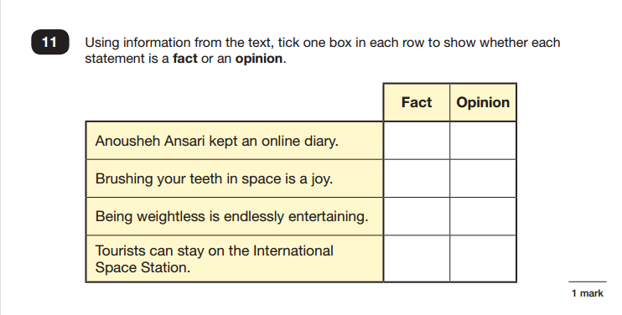

Slide 7
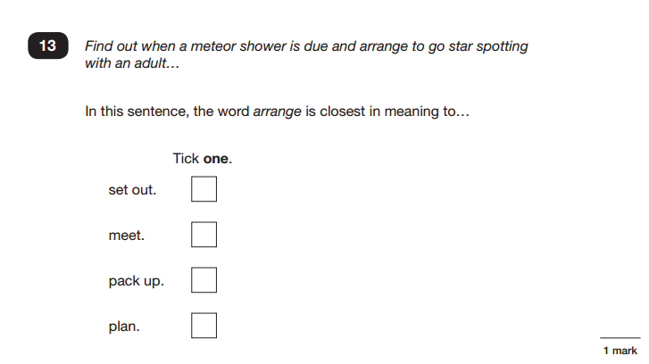

Slide 8
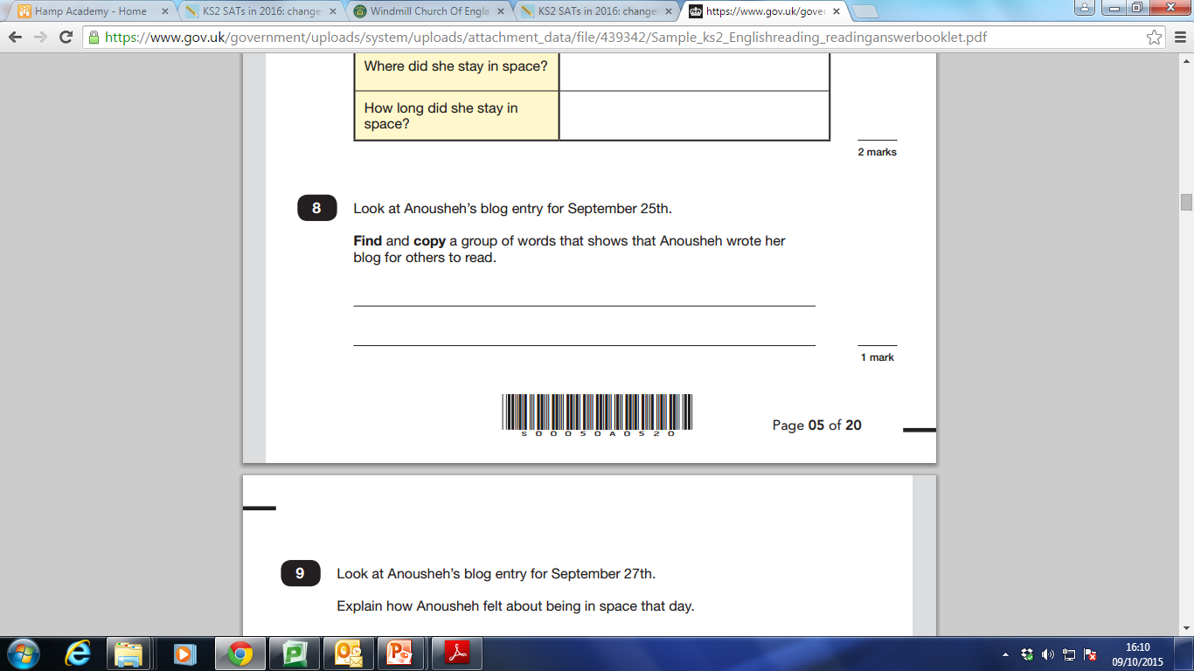

Slide 9
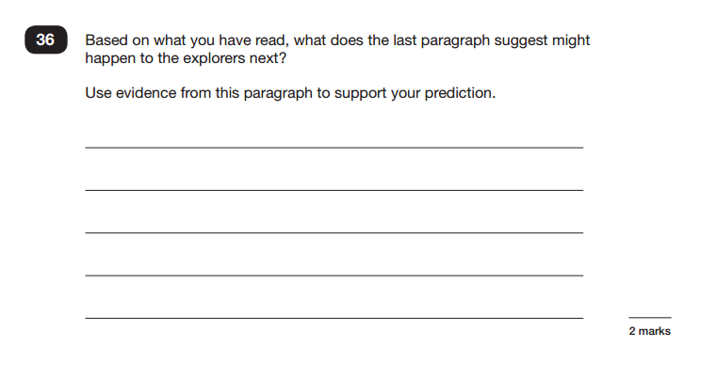

Slide 10
How to help your child with Reading
Listen to your child read regularly.
Focus on developing an enjoyment and love of reading.
Enjoy stories together – reading stories to your child at KS2 is equally as important as listening to your child read.
Read a little at a time but often, rather than rarely but for long periods of time!
Talk about the story before, during and afterwards – discuss the plot, the characters, their feelings and actions, how it makes you feel, predict what will happen and encourage your child to have their own opinions. What impression of the character do you have?
Look up definitions of words together – you could use a dictionary, the internet or an app on a phone or tablet. Children need to have a broad and rich vocabulary.
All reading is valuable – it doesn’t have to be just stories. Reading can involve anything from fiction and non-fiction, poetry, newspapers for children (The Week Junior, First News), magazines, football programmes, recipes, instructions.
Visit the local library if/when you can - it’s free!

Slide 11
Key Stage 2 Spelling, Punctuation and Grammar
The grammar, punctuation and spelling test will consist of two parts: a grammar and punctuation paper requiring short answers, lasting 45 minutes, and an aural spelling test of 20 words, lasting around 15 minutes.
The grammar and punctuation test will include two sub types of questions:
Selected response, e.g. ‘Identify the adjectives in the sentence below’
Constructed response, e.g. ‘Correct/complete/rewrite the sentence below,’ or, ‘The sentence below has an apostrophe missing. Explain why it needs an apostrophe.’
Slides 12-14 have example questions
Slides 15-16 have examples of the type of spelling rules they will be tested on.

Slide 12
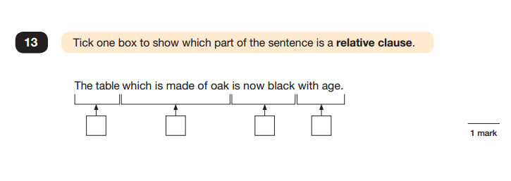
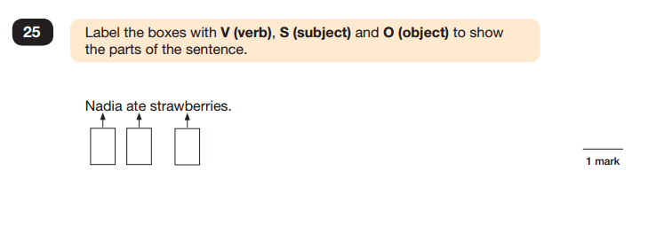

Slide 13
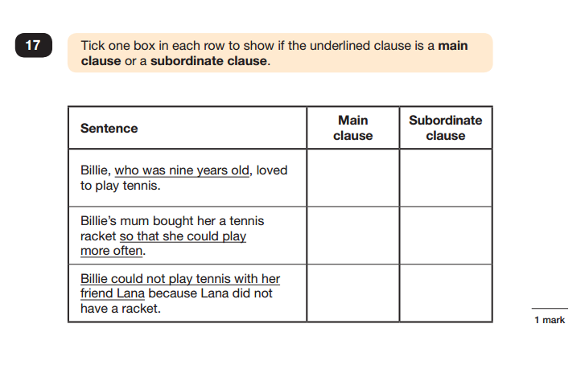

Slide 14
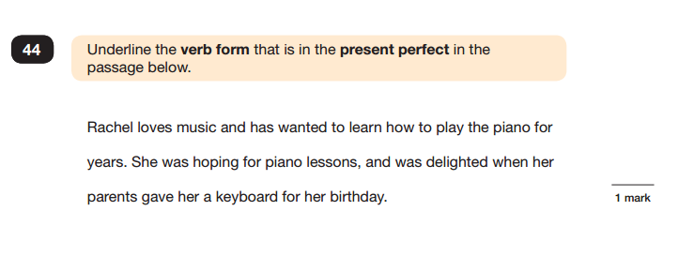

Slide 15
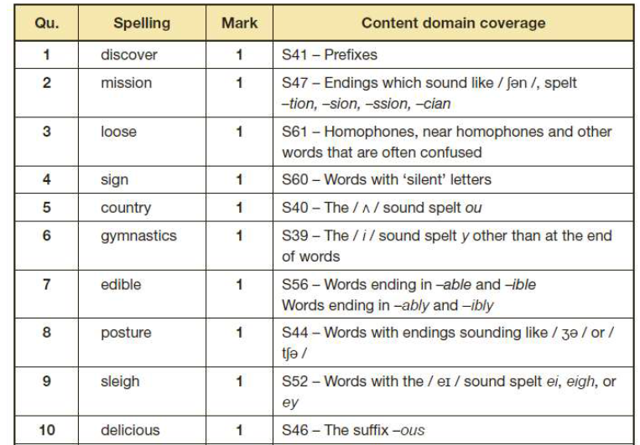

Slide 16
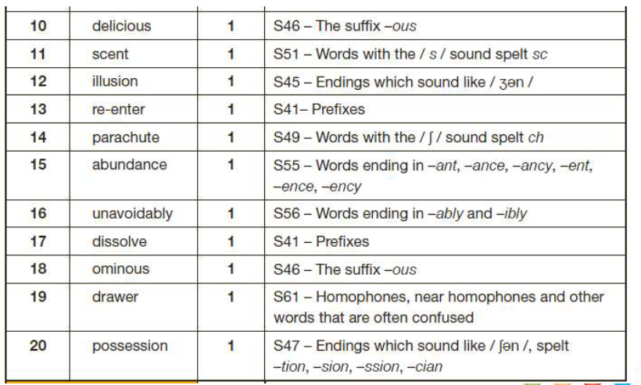

Slide 17
Key Stage 2 Maths Tests
Children will sit three papers in maths:
Paper 1: arithmetic, 30 minutes (written)
Papers 2 and 3: mathematical fluency, solving problems and reasoning, 40 minutes per paper
Paper 1 will consist of fixed response questions, where children have to give the correct answer to calculations, including long multiplication and division.
Papers 2 and 3 will involve a number of question types, including:
Multiple choice
True or false
Constrained questions, e.g. giving the answer to a calculation, drawing a shape or completing a table or chart
Less constrained questions, where children will have to explain their approach for solving a problem.
Slides 18-22 have example arithmetic questions
Slides 23-26 have example reasoning questions

Slide 18
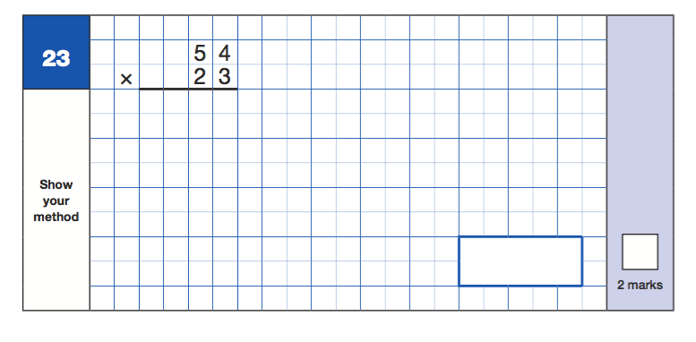
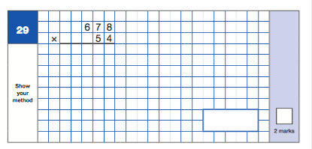

Slide 19
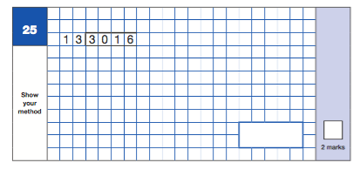
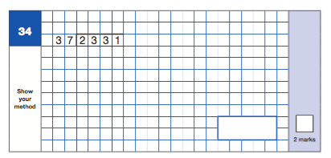

Slide 20
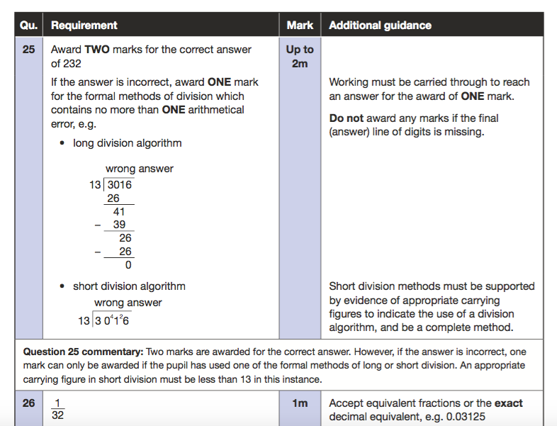

Slide 21
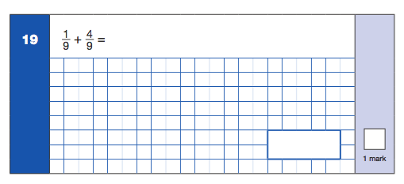
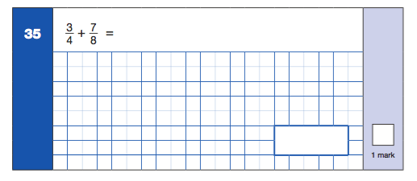

Slide 22
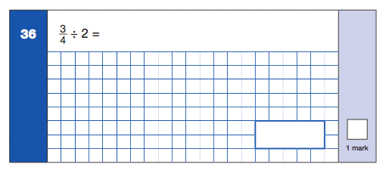
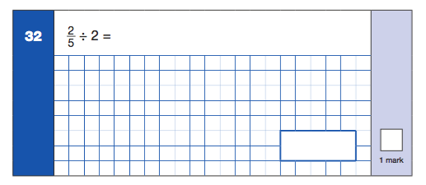

Slide 23
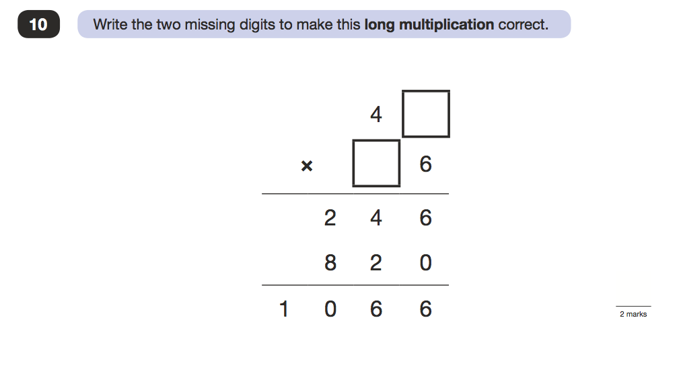

Slide 24
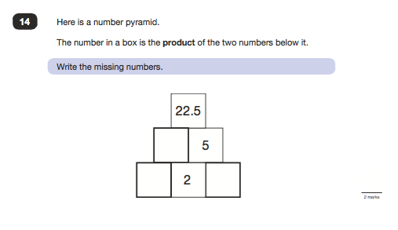

Slide 25
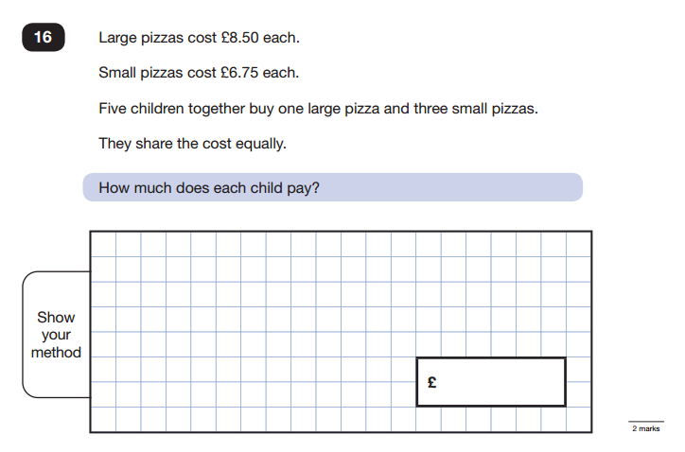
Maths Paper 2 / Paper 3 : Reasoning

Slide 26
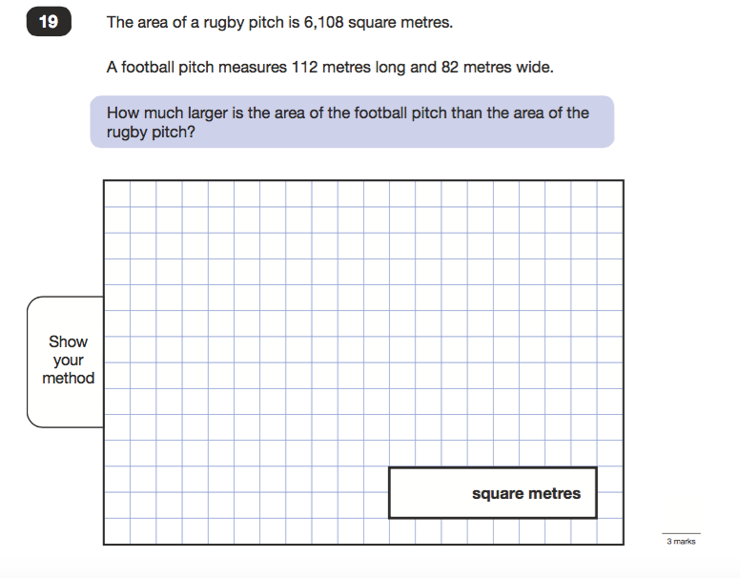

Slide 27
Common errors
Missing out the correct unit of measurement in the answer
General presentation – final answer not being clear
Numbers not clearly formed e.g. ‘0’ looking like a ‘6’
Decimal points – missing them out or making them look like a comma
2 step problems – make sure children follow the whole question through
Recording the monetary values incorrectly e.g. must be £8.90 not £8.9
Tick the methods - questions with plurals, sometimes children only tick 1 box

Slide 28
How to help your child with Maths
Identify, weigh or measure quantities and amounts in the kitchen or in recipes and adapt recipes for different amounts of people
Budgeting tasks – food, utilities and holidays
Timetables – trains, flights, time zones
Play games involving numbers or logic, such as dominoes, card games, darts, board games or chess.
DIY - encourage estimation – how heavy, how long etc

Slide 29
Key Stage 2 Writing
Children will not be tested on their writing during SATs Week. After being ‘Teacher Assessed’, children’s writing will be moderated within school and with other schools and 25% of schools will be moderated by LA.
Final judgements will be reported to parents/carers along with the result of all SAT’s tests in July. These will also be passed onto your child’s secondary school.
There are exemplars on –line which show what an expected child’s work looks like https://www.gov.uk/government/publications/2018-teacher-assessment-exemplification-ks2-english-writing
A pupil’s writing should meet all of the statements within the standard at which they are judged. The standards will be outlined in the next slide. However, teachers can use their discretion to ensure that, on occasion, a particular weakness does not prevent an accurate judgement being made of a pupil’s attainment overall.

Slide 30
End-of-key stage 2 Statutory Assessment –
Working towards the expected standard
The pupil can:
write for a range of purposes
use paragraphs to organise ideas
in narratives, describe settings and characters
in non-narrative writing, use simple devices to structure the writing and support the reader (e.g. headings, sub-headings, bullet points)
use capital letters, full stops, question marks, commas for lists and apostrophes for contraction mostly correctly
spell correctly most words from the year 3 / year 4 spelling list, and some words from the year 5 / year 6 spelling list*
write legibly.

Slide 31
End-of-key stage 2 Statutory Assessment –
Working at the expected standard
The pupil can:
write effectively for a range of purposes and audiences, selecting language that shows good awareness of the reader (e.g. the use of the first person in a diary; direct address in instructions and persuasive writing)
in narratives, describe settings, characters and atmosphere
integrate dialogue in narratives to convey character and advance the action
select vocabulary and grammatical structures that reflect what the writing requires, doing this mostly appropriately (e.g. using contracted forms in dialogues in narrative; using passive verbs to affect how information is presented; using modal verbs to suggest degrees of possibility)
use a range of devices to build cohesion (e.g. conjunctions, adverbials of time and place, pronouns and synonyms) within and across paragraphs
use verb tenses consistently and correctly throughout their writing
use the range of punctuation taught at key stage 2 mostly accurately (e.g. inverted commas and other punctuation to indicate direct speech)
spell correctly most words from the year 5 / year 6 spelling list, and use a dictionary to check the spelling of uncommon or more ambitious vocabulary
maintain legibility in handwriting when writing at speed

Slide 32
End-of-key stage 2 statutory assessment –
Working at Greater depth
The pupil can:
write effectively for a range of purposes and audiences, selecting the appropriate form and drawing independently on what they have read as models for their own writing (e.g. literary language, characterisation, structure)
distinguish between the language of speech and writing and choose the appropriate register
exercise an assured and conscious control over levels of formality, particularly through manipulating grammar and vocabulary to achieve this
use the range of punctuation taught at key stage 2 correctly (e.g. semi-colons, dashes, colons, hyphens) and, when necessary, use such punctuation precisely to enhance meaning and avoid ambiguity.^
[There are no additional statements for spelling or handwriting.]

Slide 33
How to help your child with writing
Encourage opportunities for writing such as letters to family or friends, shopping lists, notes or reminders, stories or poems.
Write together – be a good role model for writing.
Encourage use of a dictionary to check spelling and a thesaurus to find synonyms and expand vocabulary.
Insist on cursive joined handwriting and best presentation when appropriate
Remember that good readers become good writers! Identify good writing features when reading (e.g. vocabulary, sentence structure, punctuation).

Slide 34
How are the tests assessed and reported?
KS2 tests are externally marked and marks are returned to schools
To receive a scaled score, pupils must take each test paper for the subject. Schools will report to parents their child’s:
raw score
scaled score (except where a pupil has too few marks to be awarded the lowest scaled score)
either ‘NS’ (expected standard not achieved) or ‘AS’ (expected standard achieved)
The lowest scaled score that can be awarded on a KS2 test is 80. The highest scaled score is 120.
Pupils scoring at least a scaled score of 100 will have met the expected standard in the test.
A pupil awarded a scaled score of 99 or less has not met the expected standard in the test.
You will get your child’s results with their report in July.

Slide 35
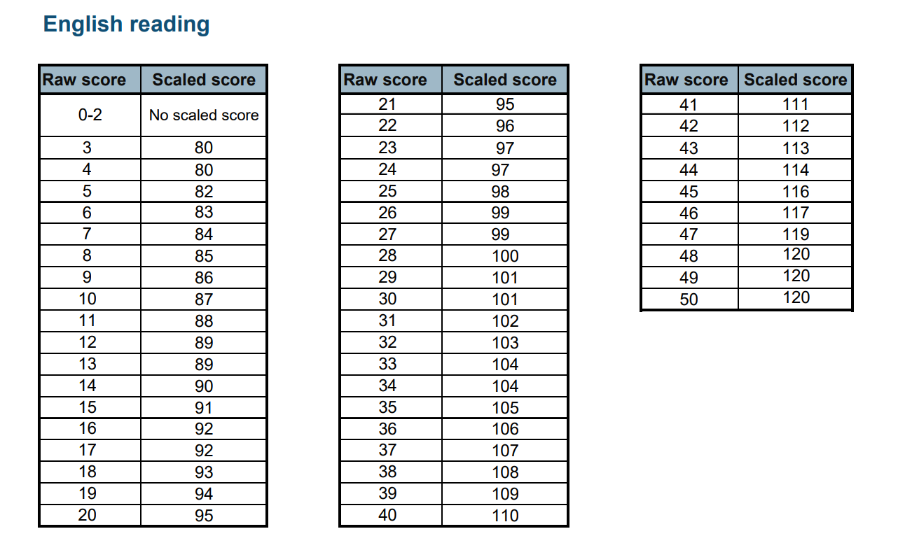
Example of the Scaled Score for 2025 Reading in 2025

Slide 36
Standardised Score | Raw scores
BELOW 100 | BELOW STANDARD
100 or above | ACHIEVED STANDARD (2025) Reading raw score was 28/50 Grammar and Spelling raw score was 35/70 Maths raw score was 58/110 There is no greater depth for these subjects, but a guide would be a scaled score of 110 or above.
 | Writing Below expected Standard, Achieved Expected Standard or At Greater Depth. This is done through moderation within school, TKAT and Wokingham LA.

Slide 37
What help can the children have when doing the tests?
Reading paper – children have to read the text and answer questions independently
Maths and Grammar papers- teachers can read questions to the children when they ask
Teachers can encourage, but not guide or correct

Slide 38
How to support your Year 6 children?
First and foremost, support and reassure your child that there is nothing to worry about and they should always just try their best. Praise and encourage!
Ensure your child has the best possible attendance at school and that they are punctual
Support your child with any home learning tasks
Do things which don’t feel like learning – Board games, helping with recipes and cooking, reading timetables, checking food bills are accurate – check receipts, help with DIY
Class Pages of school website
Practice Papers (including short 10 minute practice tests)
https://www.cgpbooks.co.uk/resources/primary-sats-resources .
https://mmerevise.co.uk/ks2-revision/maths-made-easy-ks2-sats-practice-papers/
You can also purchase from Amazon, and Waterstones or other book shops. They are useful to do, so children get used to the timings too. Please don’t use any past SAT’s Papers from previous years (2022 -2025), as we use some of them in school, usually under test conditions.
Maths website for arithmetic https://myminimaths.co.uk/year-6-mini-maths/
BBC bitesize - https://www.bbc.co.uk/bitesize/articles/z7ch6v4
All Subjects https://classroom.thenational.academy/subjects-by-key-stage/key-stage-2

Slide 39
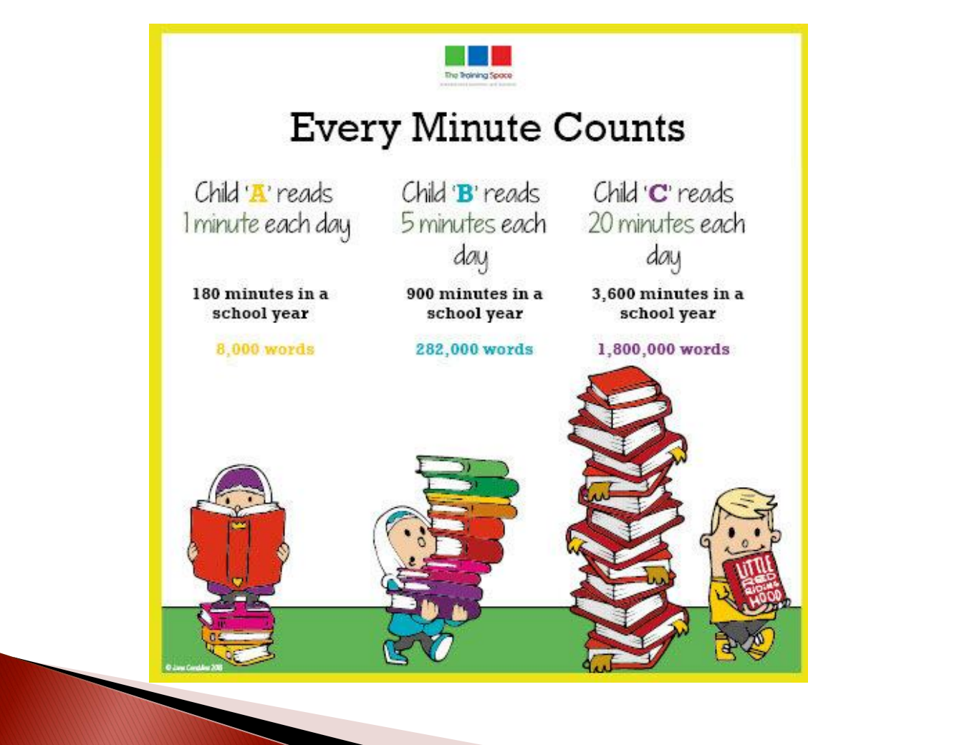

Slide 40

Thank you for listening

