Slide 1


Welcome to Year 5.

Slide 2

Expectations in Sycamore Class
Follow our “EXPECTED BEHAVIOURS:”
Follow instructions
Listen to others
Respond appropriately
Keep hands, feet and objects to yourself
Be respectful and kind
Live our School Values:
Love, Respect, Aspiration and Courage
Expectations of work – Try your hardest and do the best you can do.
Learn from mistakes and feel proud of what you have achieved.
Follow the agreed Class Charter, linked to school values

Slide 3
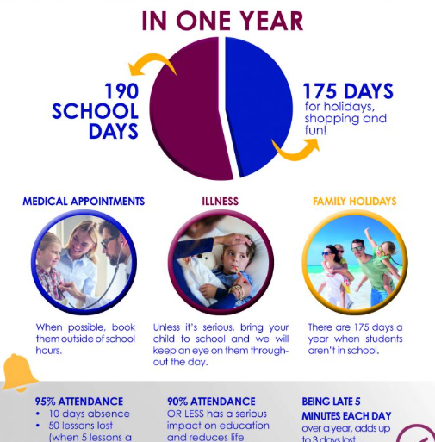

Slide 4
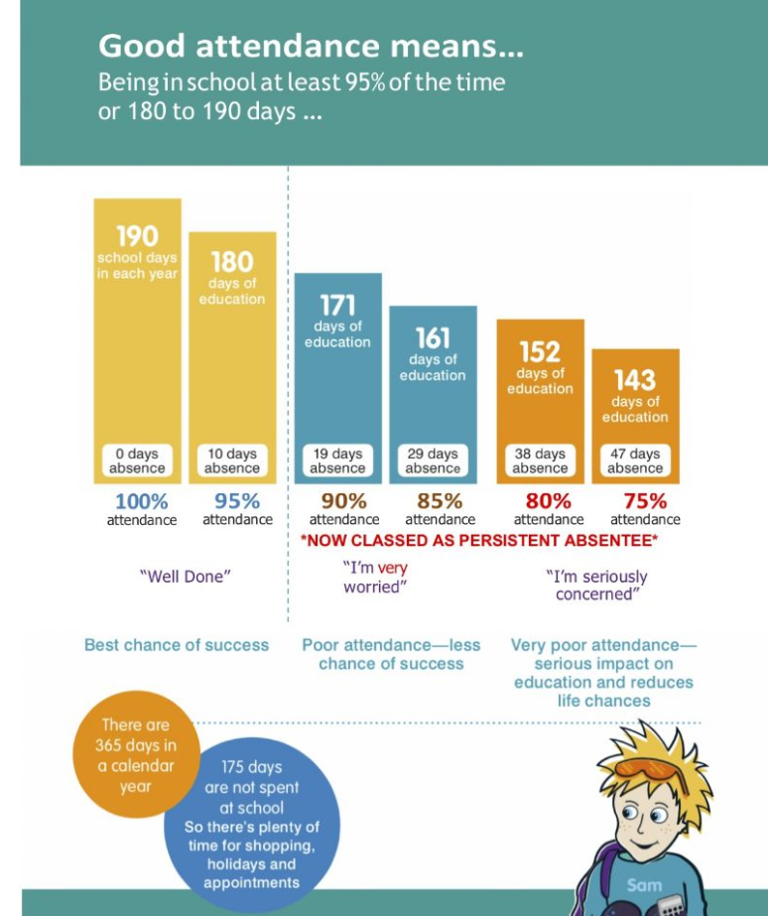

Slide 5
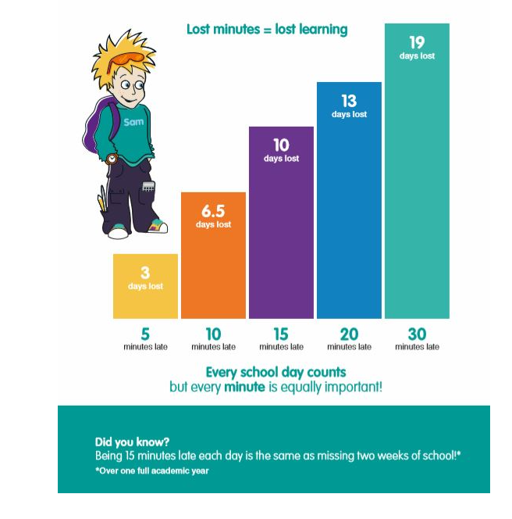

Slide 6
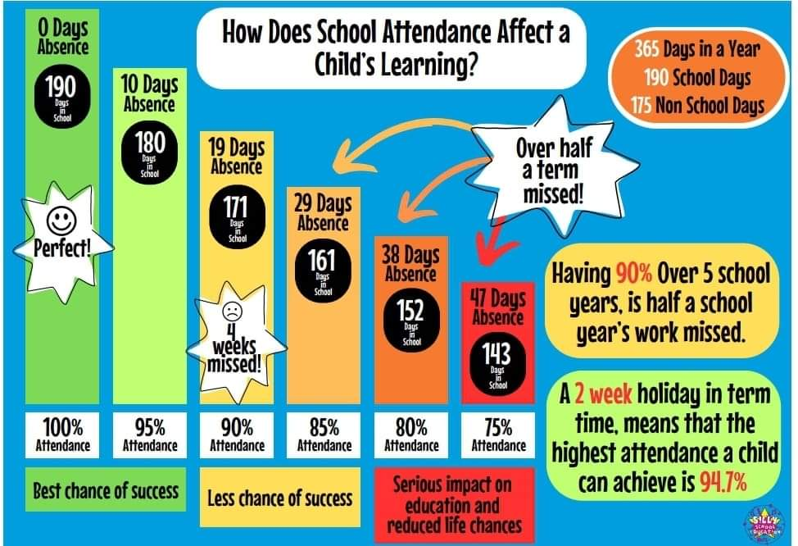

Slide 7
Equipment and Uniform
Check stationery is ready – a named pencil case with: pens (at least 2, not biro), coloured pencils, pencil (at least 2), glue stick (ideally Pritt Stick), eraser, sharpener, and a 30cm ruler, highlighters
School uniform in line with School Uniform Policy – please can their sweatshirt/s be named.
Reading book/home learning diary
Named water bottle
Other useful items: a watch, checklist of what they need each day and get ready the night before.

Slide 8



Slide 9
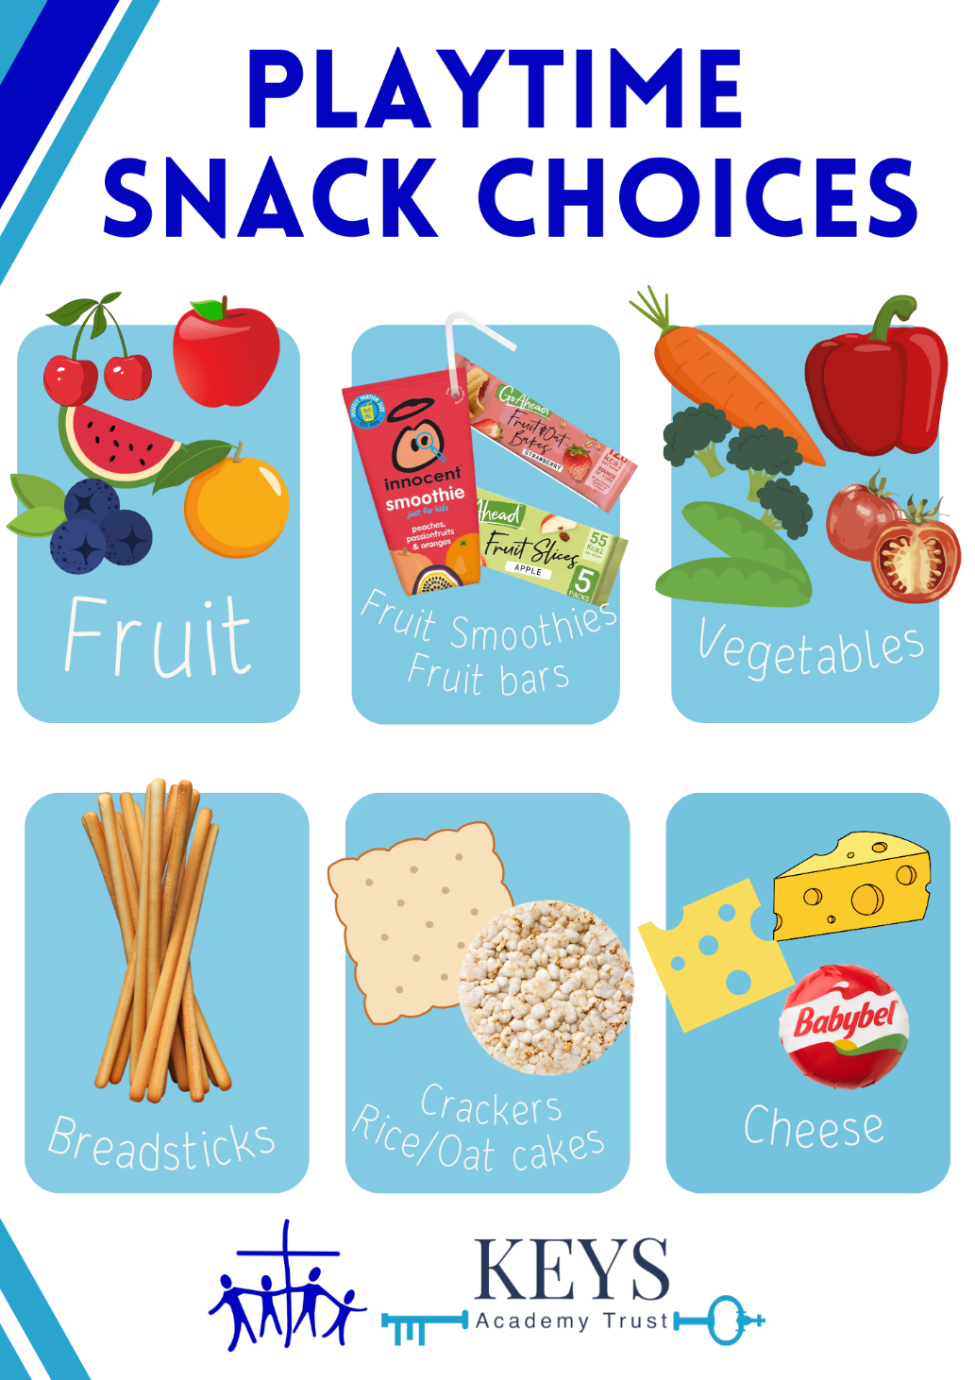
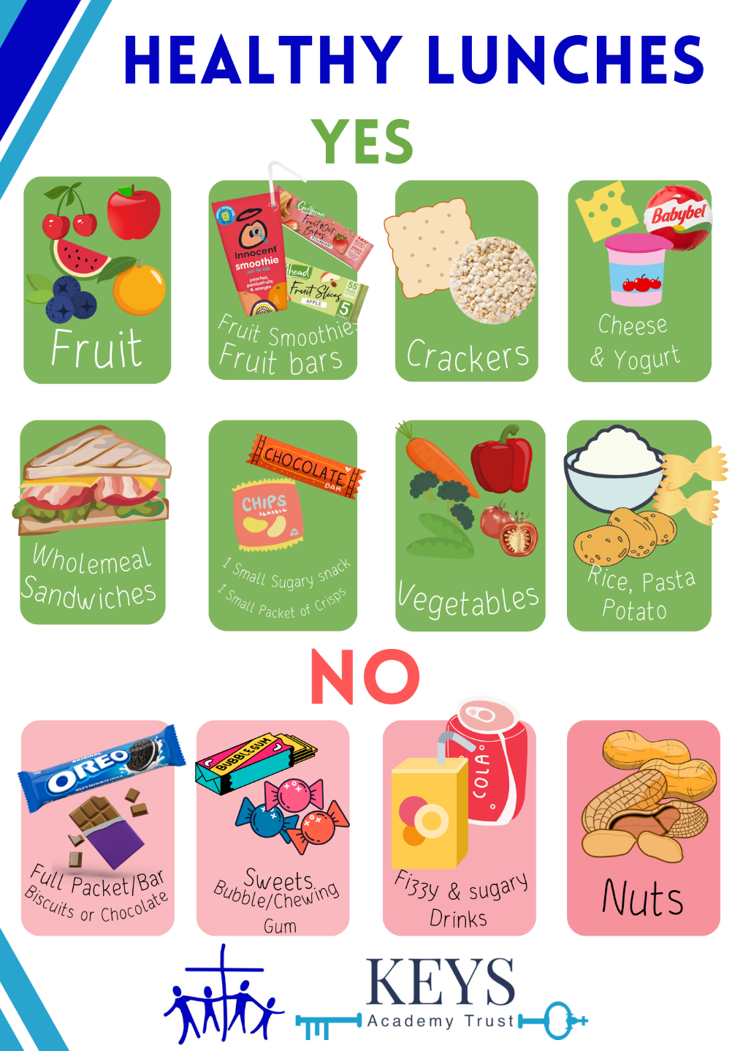

Slide 10
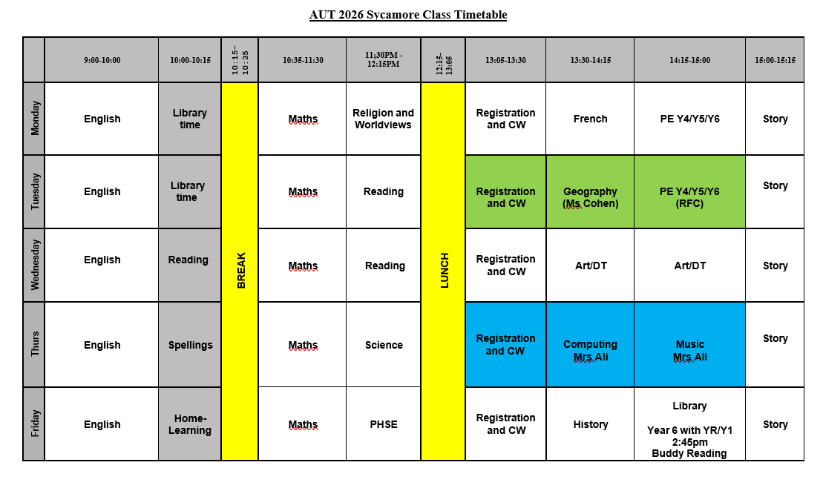

Slide 11
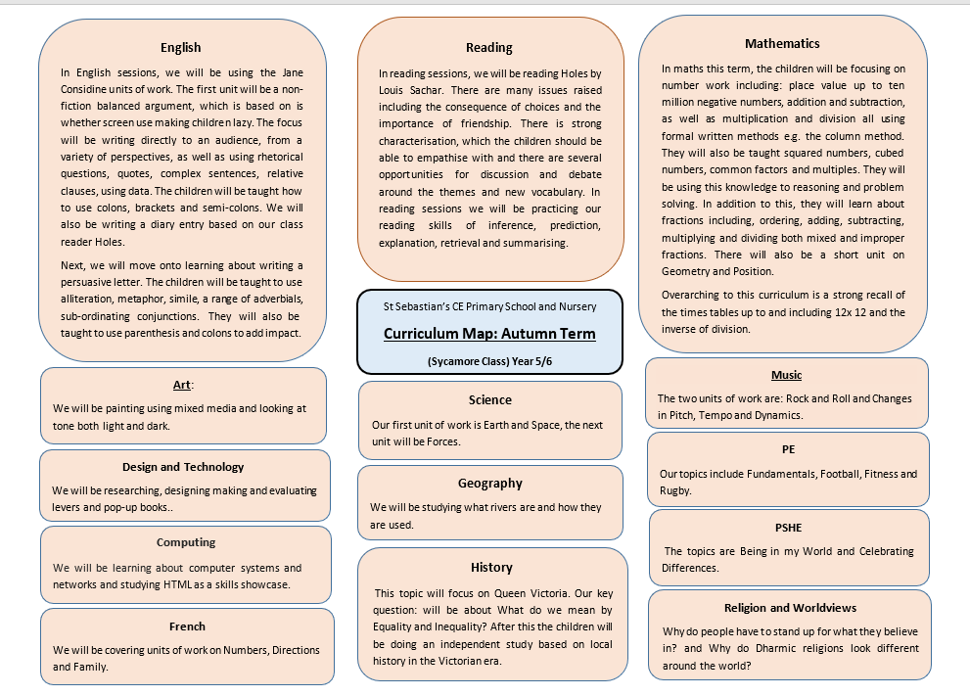

Slide 12
Rewards and Responsibilities
Rewards : Dojo Points – at the end of each month, winning family group get extra play.
Headteacher sticker for effort and achievement
Share work with other teachers
Cup and certificate in celebration assembly
35 Dojo points can wear non-school uniform
If it’s your birthday you can wear non-school uniform
Responsibilities: Sticking to Charter promises, having a job in class, being a role model to younger pupils.
Optional responsibilities: Door duty at break or/and lunch, being a playground buddy, being a representative on Pupil Parliament, being a worship leader and being a librarian

Slide 13
Enrichment and Events
Ufton Court Residential – Mon 15th – Wed 17th April (Please sign up and pay on Arbor)
Reading Museum Trip - Tues 10th Nov - Own transport
Science Morning – WonderDome - Fri 13th Nov
KS2 Concert in St Sebastian’s Church – Wed 16th Dec – 6:00pm
Wellington College – Dance Show – December
Chemistry Spectacular -March
Harvest Festival, Remembrance Day, National Poetry Day , Anti-Bullying Week, Number Day, Vision and Values Day, World Book Day, On-line Safety Day
Whole school trip - July

Slide 14
Partnership Between Parents and Teachers
Parents’ Evenings
Autumn – Mon 2nd Nov/Tues 3rd
Spring Term – Mon 22nd Nov Tues 23rd
Parent/teacher meetings can be arranged at the office or on Class Dojo. I am also happy to be contacted by email or a note, if it is important.
Open Classrooms once per term
Class Museum in SPR Term
Volunteers (will need a DBS check) – Hearing readers, PTA, curriculum days
I post on Class Dojo on a weekly basis, any home-learning, reminders and updates. Also, photos and information about what the children have been learning.
Summer Report and Report Discussion (if required)

Slide 15
Home-Learning
Year 5 and Year 6 children also have a home learning diary, which enables them to become more independent. This has their timetable in and any additional notes and home-learning. This is also used to replace reading diary from last year. Children in Year 5 are expected to read 3x a week at home and have their home-learning diary signed (name of book, pages they’ve read and signature).
Spellings (which include Y5/Y6 words), they should’ve already brought a booklet of spellings home, as they also have one in school. They are tested on spellings weekly.
TTRS – 15mins weekly
Home-learning Club – Children may do their home-learning at lunch on a Fri in advance if they wish. If there home-learning is not done, they will need to attend home-learning club as a consequence. However, if there is a good reason then that is fine. The children may complete TTRS at break or lunch during the week if they prefer.
Once per term they will also have a project or an additional piece of work
There are also additional ideas to support your child on the class page of the website

Slide 16
Help at Home
Support with home-learning eg quiz children on knowledge organisers (see next slide), help learn spellings Times Tables (TTR Rockstars). Check home-learning diaries. Use class page on website (Y5 links to support your child).
Real life maths problems, help with telling the time (digital and analogue)
Encourage your child to read and write – Hear your child read and sign in home-learning-diary. Encourage them to have a love of reading, take them to a book signing of favourite author or a book festival.
Suggested books : Lots are available at Wokingham Library
https://schoolreadinglist.co.uk/reading-lists-for-ks2-school-pupils/year-5/
https://schoolreadinglist.co.uk/reading-lists-for-ks2-school-pupils/suggested-reading-list-for-year-6-pupils-ks2-age-10-11/
Help your child to become more independent and responsible. Check everything is ready the night before if possible.

Slide 17


Slide 18


Slide 19
Knowledge Organisers
What is a Knowledge Organiser:
Knowledge organisers contain the essential information and vocabulary that will help your child access a new topic in class. The knowledge organisers are also designed to be used at home to help children learn the key facts and information. Your child will be learning the same information, as part of their learning in class.
How are they used in class:
A Knowledge Organiser will be given to a child prior to the start of a new topic. The teacher will read through it with the child and explain it to them. All the knowledge organisers for the term are on Sycamore Class page of the website (art, computing, French, history, geography, PHSE, religion and worldviews). The Knowledge Organisers will be used in lessons and constantly referred back to. They will have a quizzes on the key information.

Slide 20
How you can support your child with their Knowledge Organisers:
Children read the information from the Knowledge Organiser at regular points throughout the half term (ideally with an adult).
Discuss the information together, focussing on your child reading and understanding the information contained.
Revisit the document regularly over the half term and ask your child what else they have learnt in class that expands upon the facts in the Knowledge Organiser.
Discuss the new vocabulary on the Knowledge Organiser and model using these words in a sentence, or discuss definitions to help your child develop their understanding of these new words.
Help your child to develop their understanding of their topic by visiting the library to borrow some information books (library staff will be able to help you to locate relevant books); research on the internet with adult support and supervision.
They shouldn’t place any unnecessary stress upon a child and should be a wonderful opportunity for you to be part of the learning process. We are confident that these Knowledge Organisers will help children to develop knowledge on a wide range of topics and will significantly improve their vocabulary and understanding. This will then help them to be more confident in class and help to develop their reading and writing skills across the curriculum.

Slide 21

Thank you for listening and for your time.
Any questions?

