Slide 1


Welcome to Year 6.

Slide 2
Expectations in Sycamore Class
Attendance and punctuality.
EXPECTED BEHAVIOURS
Follow instructions
Listen to others
Respond appropriately
Keep hands, feet and objects to yourself
Be respectful and kind
Living our School Values: Love, Respect, Aspiration and Courage through our Year 6 Charter promises
Expectations of work – Try your hardest and do the best you can do. Learn from mistakes and feel proud of what you have achieved.
Follow the agreed Class Charter (agreed in class and will also go on class page on website).
Have a Trusted adult they can go to, to share any worries, also to share through zones of regulation lolly sticks.

Slide 3
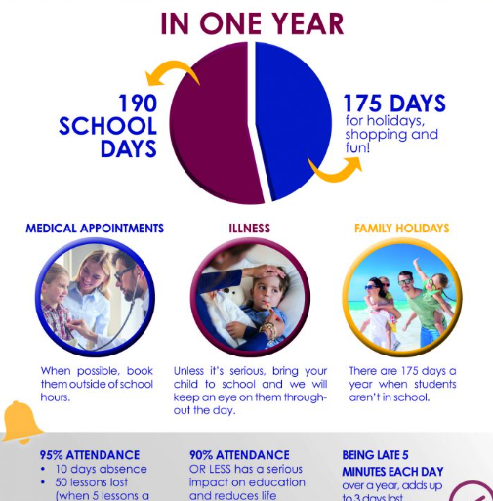

Slide 4
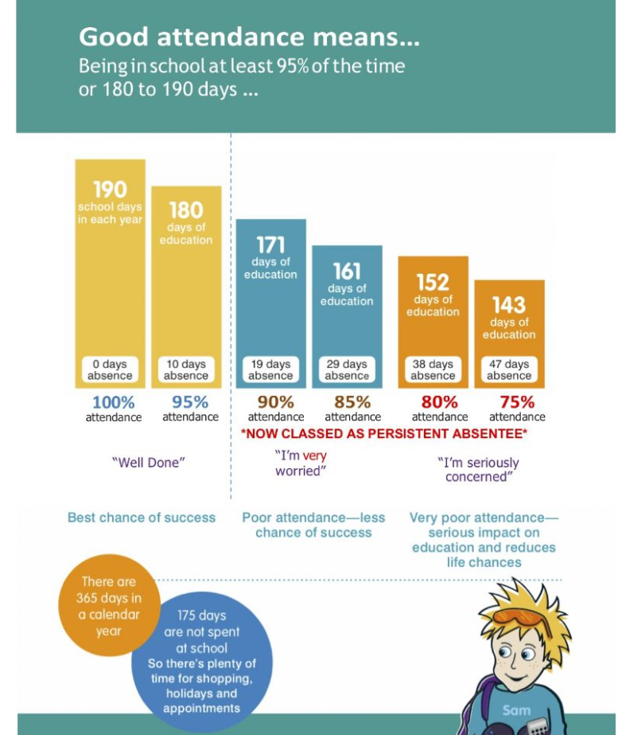

Slide 5
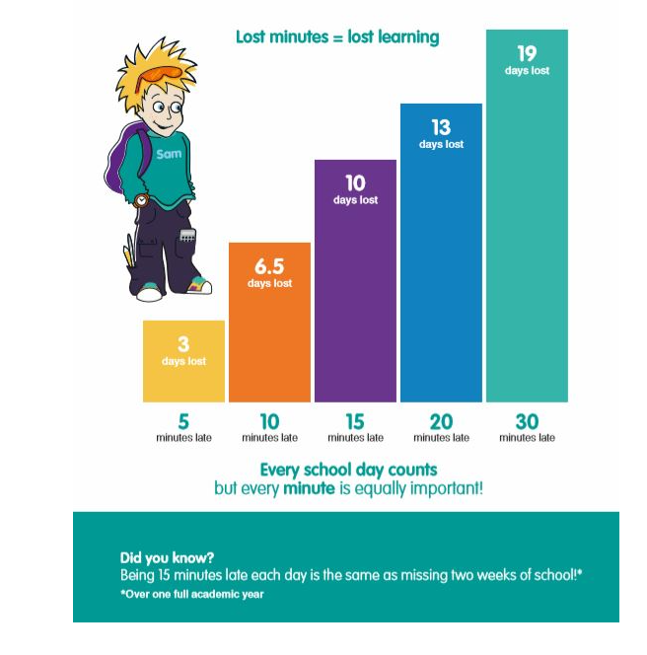

Slide 6
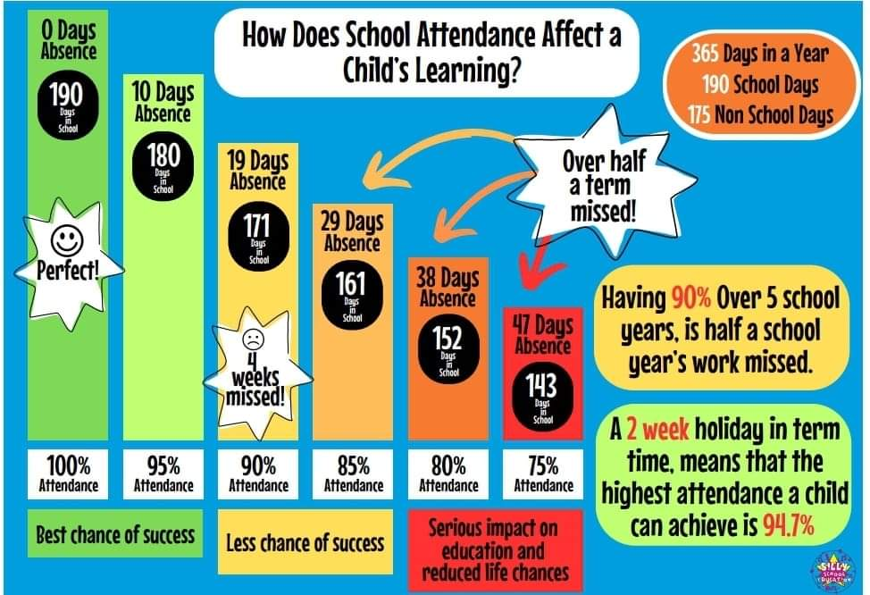

Slide 7
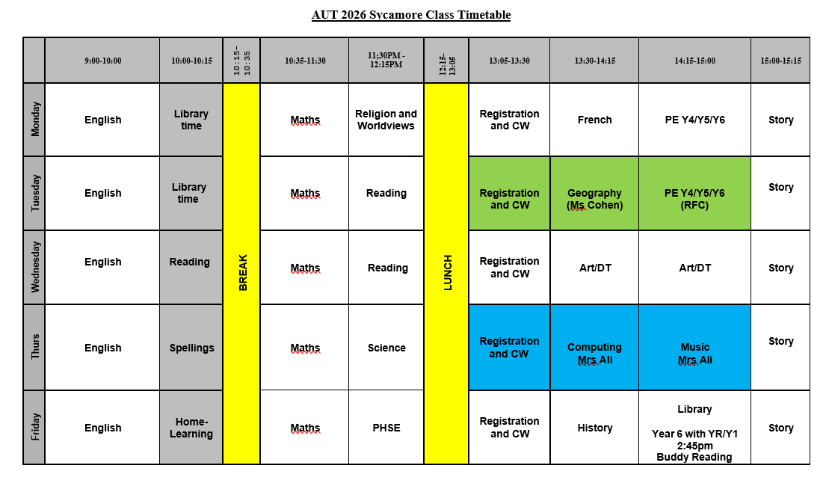

Slide 8
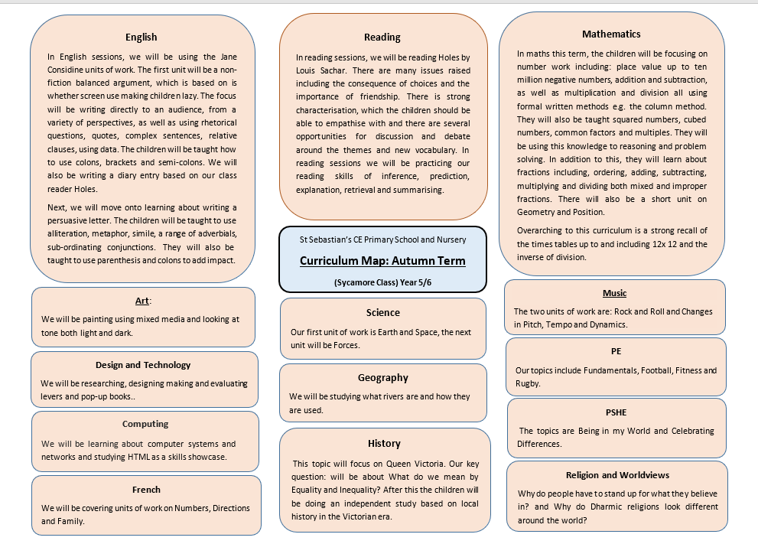

Slide 9
Equipment and Uniform
Check stationery is ready – a named pencil case with: pens (at least 2, not biro), coloured pencils, pencil (at least 2), glue stick, rubber, sharpener, and a 30cm ruler
School uniform in line with School Uniform Policy – please can their sweatshirt/s be named
Reading book/home learning diary
Named water bottle
Other useful items: a watch, highlighters, checklist of what they need each day and get ready the night before.

Slide 10
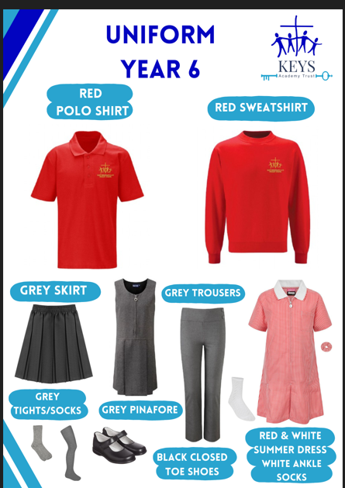


Slide 11
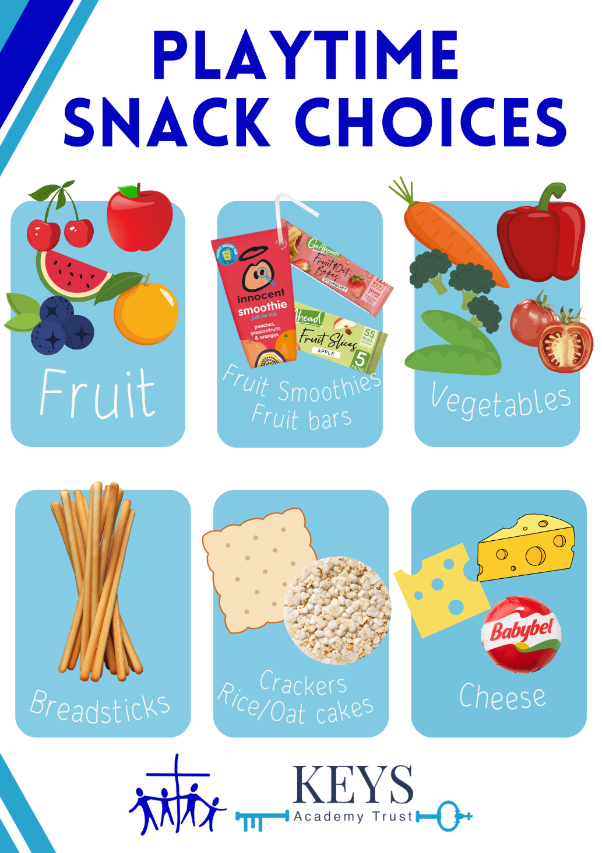
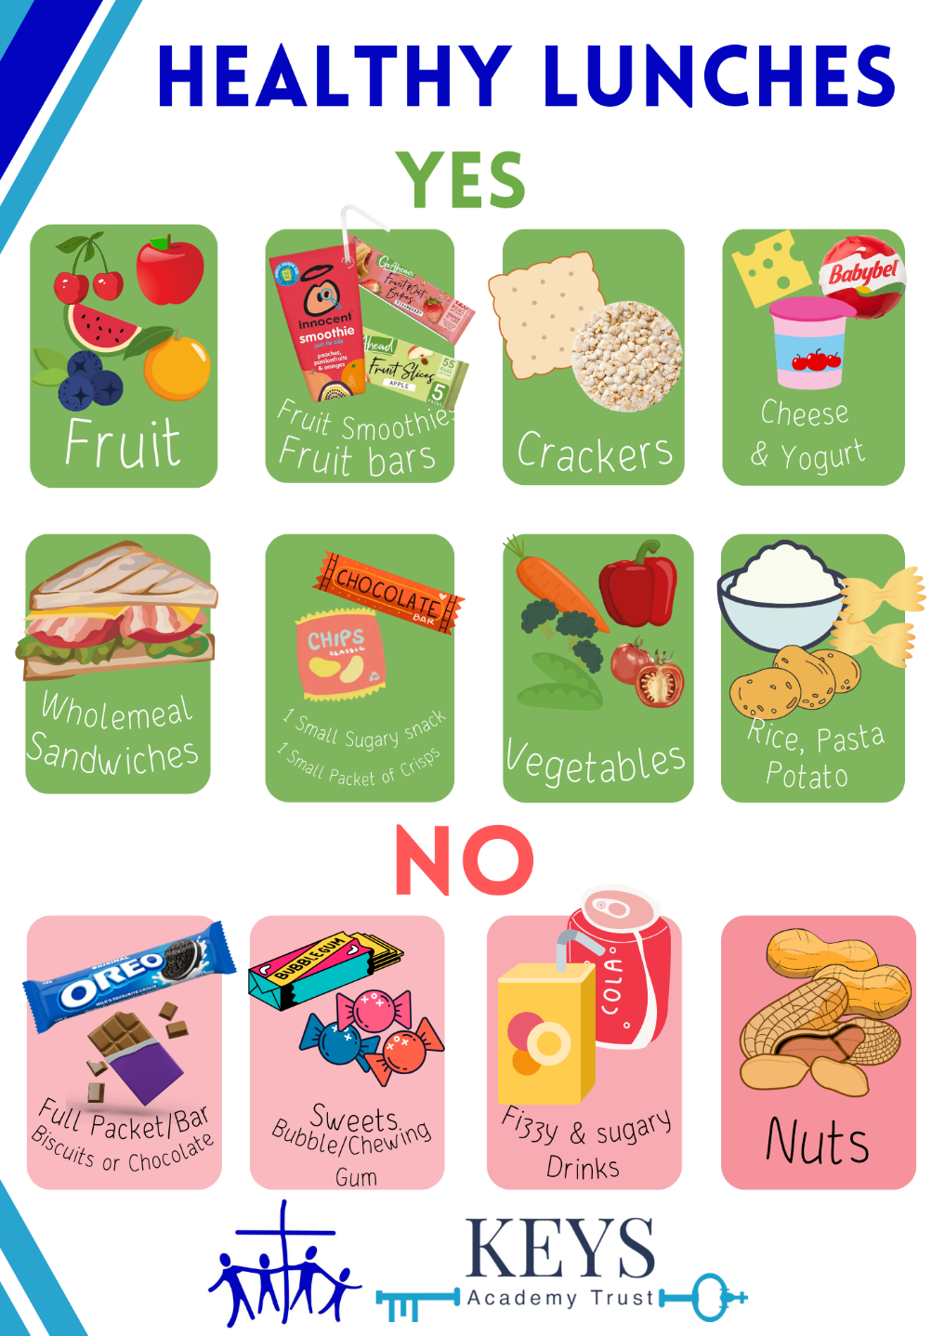

Slide 12


Slide 13


Slide 14
Rewards and Responsibilities
Rewards : Year 6 Club, Year 6 Maths Club, buddy reading, sitting on benches in Collective Worship.
Responsibilities: Sticking to Charter promises, door duty, helping at Little Angels, leading Pupil Parliament (librarian, worship leader, eco-warrior) and being great role models.

Slide 15
Enrichment and Dates for the Diary
Already booked for this year:
Charter Ceremony – Wed 16th Sept - 9:00am
Year 6 Club – Thurs 24th Sept - 3:15pm-3:15pm (sign up for the Year on Arbor)
Y6 Maths Club – Fri 25th Sept - 3:15pm- 4:15pm (sign up for the year on Arbor)
Ufton Court– Mon 15th - Wed 17th Sept - 7:30am-5:00pm (Please give consent and pay on Arbor)
Deadline for secondary school applications 31st Oct and National Offer Day 1st March
Reading Museum Trip –Tues 10th Nov – Own transport
Science Morning – Fri 13th Nov WonderDome booked
Maths Challenges - Luckley House School – (Four Year 6 children) Mon 23rd Nov 4 - 1:30pm-3:30pm. TKAT Maths Challenge
KS2 SATs Information Session – Fri 20th Nov - 3:15pm

Slide 16
Enrichment and Events
KS2 Concert in St Sebastian’s Church – Wed 16th Dec – 6:00pm (tbc)
Wellington College Chemistry Spectacular -Thurs 18th March (tbc)
KS2 SATs- Mon 10th May –Thurs 13th May
Bikeability - Mon 17^{h} May/Tues 18th May (Y6 only)
National Poetry Day , Anti-Bullying Week, Number Day, Vision and Values Day, World Book Day
Whole school trip – July
Sporting Events (tbc)

Slide 17
Partnership Between Parents and Teachers
Parents’ Evenings
Autumn – Mon 2nd/ Tues 3rd
Spring Term –Mon 22nd/ Tues 23rd
Parent/teacher meetings can be arranged at the office or on Class Dojo. I am also happy to be contacted by email or class dojo or a note, if it is important.
Class Museum Spring term
Open classrooms each term
I post on Class Dojo on a weekly basis, any home-learning, reminders and updates. Also, photos and information about what the children have been learning.
Summer Report and Report Discussion (if required)

Slide 18
Home-Learning
Children in Year 5 are expected to read 3x a week at home and have their home-learning diary signed (name of book, pages they’ve read and signature). They will also have, spellings (which include Y5/Y6 words) and TTRS. They are expected to complete it in the allocated time, otherwise the children will need to stay in at break to complete it and attend home-learning club on Friday. Once per term they will also have a project. There are also additional ideas on the class page of the website.
Y6 home-learning is usually given out on a Fri and handed in by Wed. I am also happy to go through again at break, lunch time before it is due to be handed in on Wed. If there is a valid reason, I am happy to give out home-learning early.
Children in Year 6 are expected to complete approximately one hour of Maths and one hour of English home learning each week. This will also include, reading, spelling and TTR. They are expected to complete it in the allocated time, otherwise the children will need to stay in at break to complete it and attend home-learning club on Friday.
Year 5 and Year 6 children also have a home learning diary, which enables them to prepare for their transition to secondary school. This needs to be signed each week, and have the name of the book they have been reading and the page numbers.

Slide 19
Help at Home
Support with home-learning eg quiz children on knowledge organisers (see next slide), help learn spellings Times Tables (TTR Rockstars). Check home-learning diaries. Use class page on website (Y6 links to support your child)..
Real life maths problems, help with telling the time (digital and analogue)
Encourage Writing and Reading – Hear your child read and sign in home-learning-diary.
Suggested books : Lots are available at Wokingham Library
https://schoolreadinglist.co.uk/reading-lists-for-ks2-school-pupils/year-5/
https://schoolreadinglist.co.uk/reading-lists-for-ks2-school-pupils/suggested-reading-list-for-year-6-pupils-ks2-age-10-11/
Help your child to become more independent and responsible. If possible check they have everything ready the night before.

Slide 20
Knowledge Organisers
What is a Knowledge Organiser:
Knowledge Organisers contain the essential information and vocabulary that will help your child access a new topic in class. The Knowledge Organisers are also designed to be used at home to help children learn the key facts and information. Your child will be learning the same information, as part of their learning in class.
How are they used in class:
A Knowledge Organiser will be given to a child prior to the start of a new topic. The teacher will read through it with the child and explain it to them. All the knowledge organisers for the term are on the class page of the website (art, computing, French, history, geography, PHSE. Religion and worldviews). The Knowledge Organisers will be used in lessons and constantly referred back to. Key Stage 2 children will have a quizzes on the key information.

Slide 21
How you can support your child with their Knowledge Organisers:
Children read the information from the Knowledge Organiser at regular points throughout the half term (ideally with an adult).
Discuss the information together, focussing on your child reading and understanding the information contained.
Revisit the document regularly over the half term and ask your child what else they have learnt in class that expands upon the facts in the Knowledge Organiser.
Discuss the new vocabulary on the Knowledge Organiser and model using these words in a sentence, or discuss definitions to help your child develop their understanding of these new words.
Help your child to develop their understanding of their topic by visiting the library to borrow some information books (library staff will be able to help you to locate relevant books); research on the internet with adult support and supervision.
They shouldn’t place any unnecessary stress upon a child and should be a wonderful opportunity for you to be part of the learning process. We are confident that these Knowledge Organisers will help children to develop knowledge on a wide range of topics and will significantly improve their vocabulary and understanding. This will then help them to be more confident in class and help to develop their reading and writing skills across the curriculum.

Slide 22
Thank you for listening
Any questions???

